Slide 1
WHAT’S RIGHT WITH YOU?
Flipping the assumption of worth
in our interactions
with children and adults

Slide 2

thank you FOR using what’s right w you to help heal a topsy-turvy world by
DEVOTING YOUR LIFE TO MAKING A DIFFERENCE TO CHILDREN & FAMILIES

Slide 3
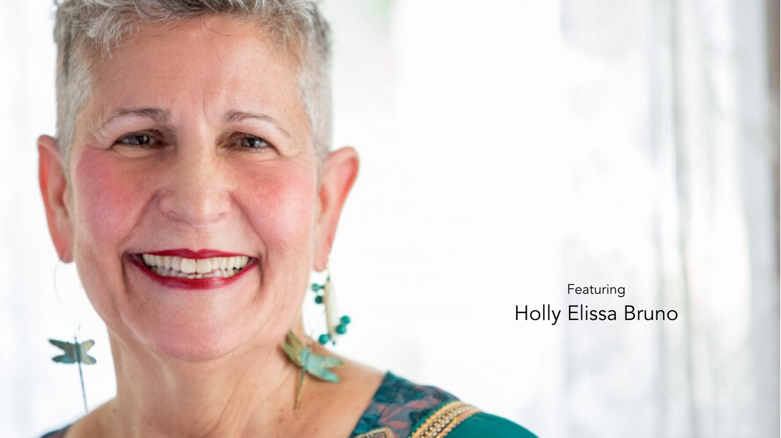
Anchorage ECE professionals
What’s right with you?
A surprising strength of yours you discovered during the pandemic;
A person you were able to help find her/his gifts and strengths.
,

Slide 4
WHAT’S RIGHT WITH YOU?
Description
Presenter
Children are often asked, overtly or covertly: “What’s wrong with you?” Adults too focus on our faults, rather than our talents/strengths. Imagine changing the conversation to: “What’s right with you?” as we seek the unique giftedness of each child, in our peers and ourselves?
A child is more than her diagnosis. An adult is more than her shortcomings. Join us in discovering how this simple change of perspective changes every interaction for the better. Rilke encourages us to “Learn to love the questions”. “What’s right with you?” is a question to love.
Holly Elissa Bruno, served as Assistant Attorney General for the state of Maine, US, Associate Professor and Dean, University of Maine-Augusta, and now keynotes internationally (virtually and in person) on Leadership and Emotional Intelligence, Managing Legal Risks, and Translating Trauma into Healing, having written best selling books on each topic.
www.hollyelissabruno.com
ActivechildhoodUK
Happiness is running through the streets to find you: Translating trauma’s harsh legacy into healing (2020)

Slide 5
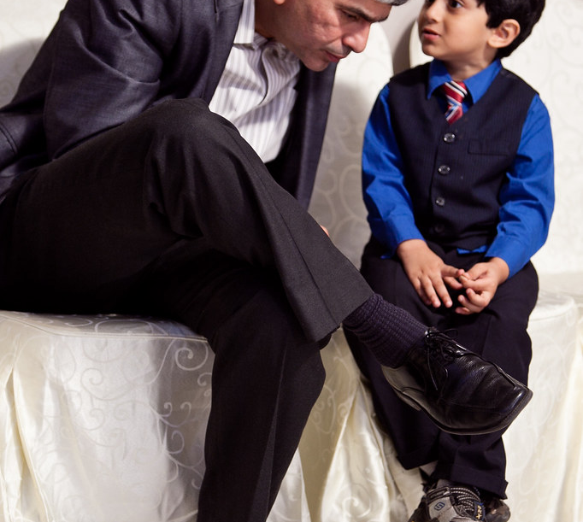
Learning goals. Participants will be invited to:
Articulate and examine assumptions we bring to each interaction.
Discuss brain’s capacity to function on fear vs. curiousity.
Practice asking: “What’s right with this person? This situation? Me?”
This Photo by Unknown Author is licensed under CC BY-NC-ND

Slide 6

SAFEGUARDS for your BOUNDARIES
You get to choose whether/how much
to participate
You can:
Pass
Count on Confidentiality
Take care of yourself
Reach out to talk one on one with a Warm Line counselor at:
877.266.4357
C.R.A.F.T.
RESPECT

Slide 7
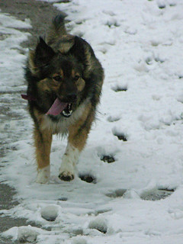
Are you
READY?
Hair toss
Check my nails
Baby, how you feeling?
Groan or Hooray?
This Photo by Unknown Author is licensed under CC BY-SA-NC
This Photo by Unknown Author is licensed underC BY-SA

Slide 8
Anchorage AEYC early childhood
professionals,
What’s right with you?
One of your strengths that helps/ed you through hard times
What’s funky and fun about you?
A way you have helped another.
,

Slide 9
Nobody else can live the life you live.
And, even though no human being is perfect,
We always have the chance to bring what’s unique about us to life.
Fred Rogers

Slide 10
Case studies
What’s right with each person, yourself?
What causes us to judge people harshly?
What helps us reboot our expectations?
Costs vs benefits of opening our hearts?

Slide 11
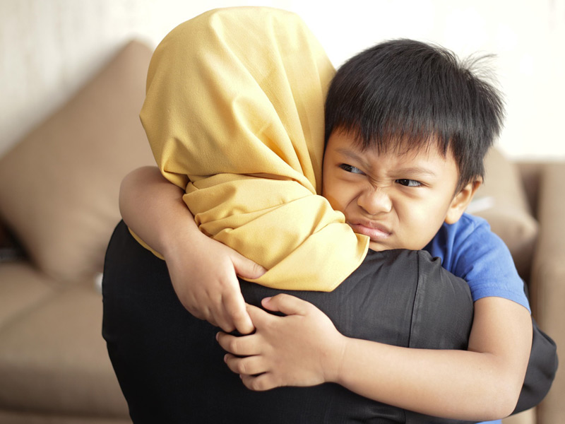
When his teacher asks him his name, he says “I’m nobody”

Slide 12

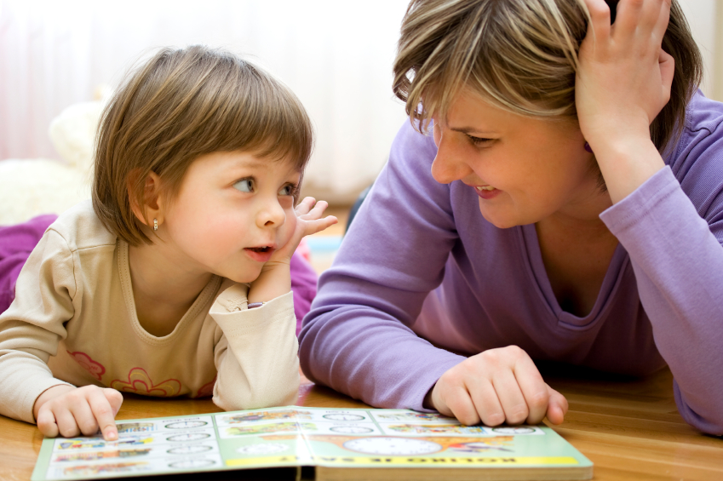
RESILIENCE: Every child deserves one adult who believes that child is the most marvelous, gifted, loveable person on earth. WV ECE Director

Slide 13
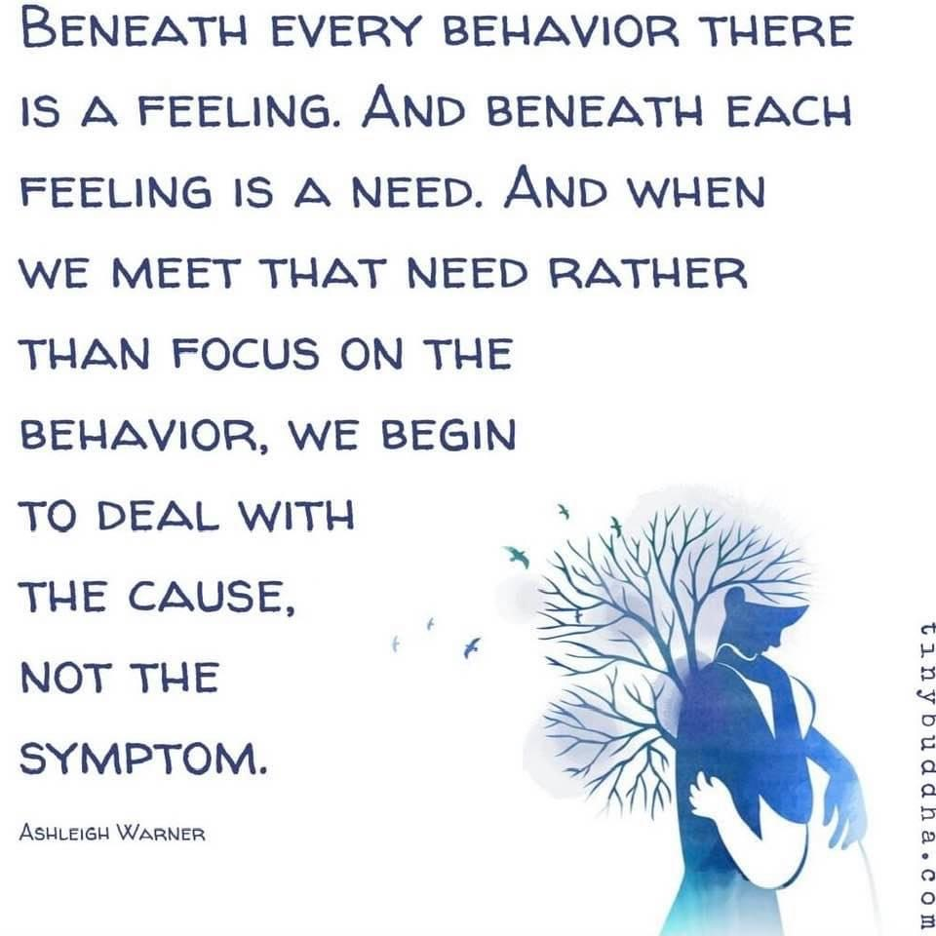

Slide 14
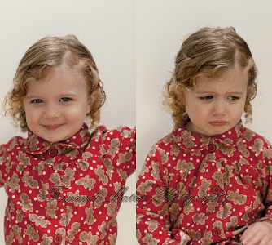
The last of the human freedoms is the ability to choose one’s attitude in any given set of circumstances.
Viktor Frankl, Man’s search for meaning
Does each child (and adult) see loving acceptance or does she
see judgment
in our eyes?
We get to choose.

Slide 15
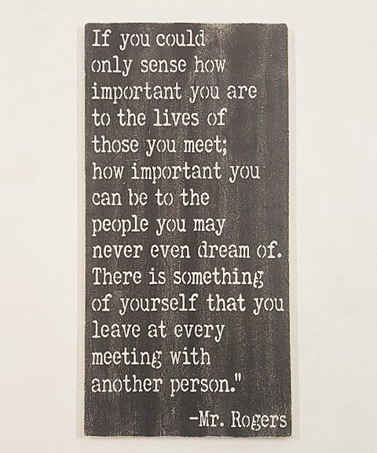

Slide 16
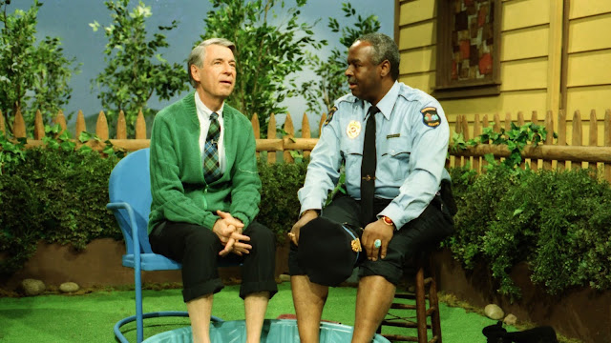
A love of learning
Has a lot
to do with learning
we are
loved.
-Fred Rogers
This Photo by Unknown Author is licensed under CC BY-NC-ND

Slide 17
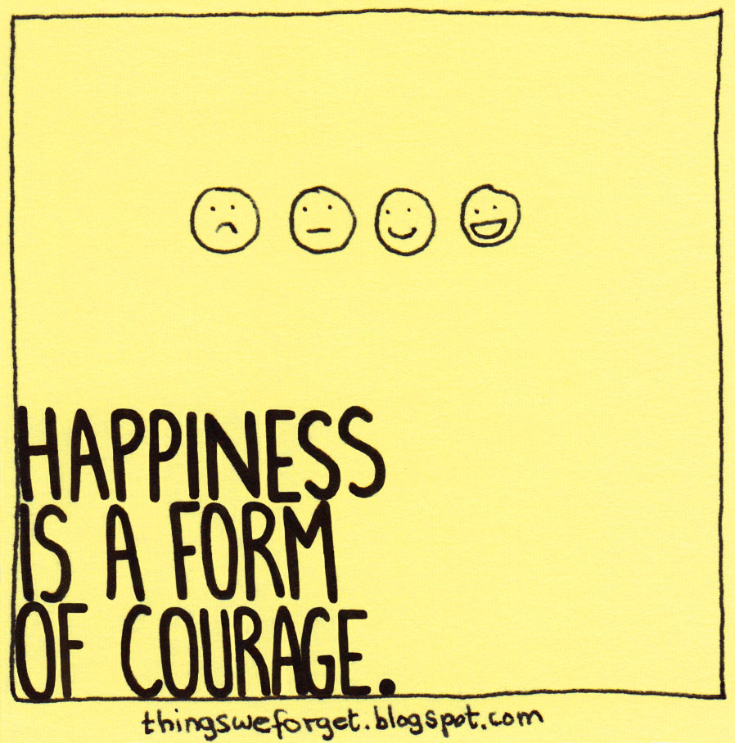
Dear dedicated
TRUE
for
YOU?
This Photo by Unknown Author is licensed under CC BY-NC-ND

Slide 18
WHAT’S RIGHT WITH YOU?
Are we meant to like ourselves?
Do children come to the earth with
positive self regard?
Were you encouraged to like yourself? Do you?

Slide 19
Do children naturally like & trust themselves?
Do adults?
What’s going on?

Slide 20
If we do not feel loved for who we are, where do we go?

Slide 21
BRAIN MATTERS
What transpires inside us when we are put down/shamed vs when we are seen, honored and respected?
How the brain responds to care vs cruelty

Slide 22
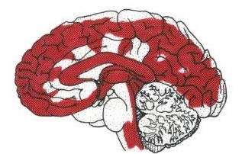
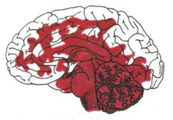
hope reframes fear, SHAME drain
OUR BRAINS
HOPE-Based
ACTOR believes in possibilities
FEAR-Based
REACTOR dreads harsh judgment
Blood pumps evenly to all parts of brain, fueling all functions, flowing to pre-frontal cortex Executive Function for perspective, creativity, innovation, optimism, clarity, HOPE.
Blood pools in amygdala, triggering “flight or fight; freeze or fawn, float” response, robbing Executive Function by up to 95% of capacity to problem solve,
stay professional. Autonomic response feels
out-of-control, panicky, can’t “think straight”.

Slide 23
Let your brain help you recover:
Humor & Laughter
Trigger prefrontal cortex or executive function activity
Our prefrontal cortex is the locus of new ideas, problem solving acumen, humor, generosity, optimism & vision for a better future.

Slide 24
Brain defaults to fear (m. lieberman) how CAN YOU RESET YOU BRAIN?
HOPE-Based
ACTOR believes in possibilities
FEAR-Based
REACTOR dreads harsh judgment
Blood pumps evenly to all parts of brain, fueling all functions, flowing to pre-frontal cortex Executive Function for perspective, creativity, innovation, optimism, clarity, HOPE.
Blood pools in amygdala, triggering “flight or fight; freeze or fawn, float” response, robbing Executive Function by up to 95% of capacity to problem solve,
stay professional. Autonomic response feels
out-of-control, panicky, can’t “think straight”.

Slide 25
“When people are able to find that sense of PLAY in their work, they truly become powerful figures”
Stuart Brown, MD

Slide 26
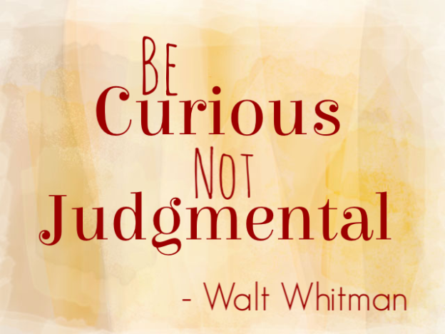

Slide 27
hope reframes SHAME drains
OUR BRAINS
HOPE-Based
ACTOR believes in possibilities
FEAR-Based
REACTOR dreads harsh judgment
Reset perserveration, stuckness with
LAUGHTER SINGING BEING CURIOUS
DANCING PLAYING OPEN TO POSSIBILITY
BEING OUTDOORS ACCEPTING
Acknowledge fear, shame, hurt , hopelessness.
Ask for and accept help. You are not longer alone.
When safe, stop running
With support, feel the fear, sorrow, panic, outrage;
Release programmed reactions; choose HOPE

Slide 28
What can you control?
Worry is an attempt to control the future
Guilt is an attempt to control the past
Resentment hurts the present
-

Slide 29
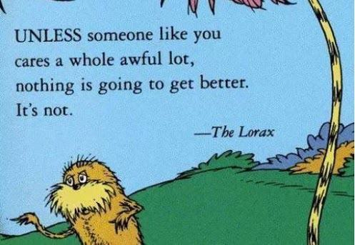
This Photo by Unknown Author is licensed under CC BY-SA-NC

Slide 30
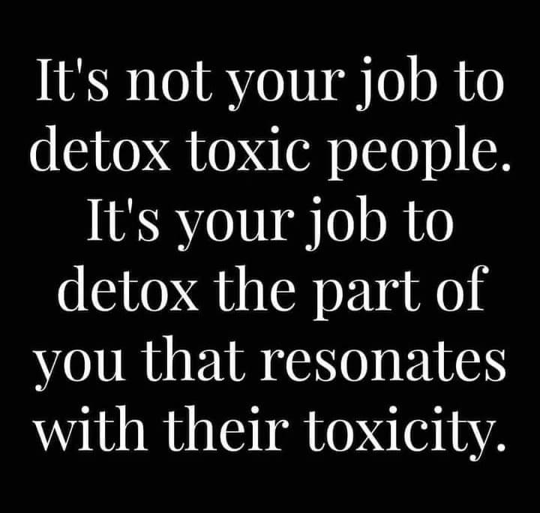

Slide 31
Case studies
What’s right with each person, yourself?
What causes us to judge people harshly?
What helps us reboot our expectations?
Costs vs benefits of opening our hearts?

Slide 32
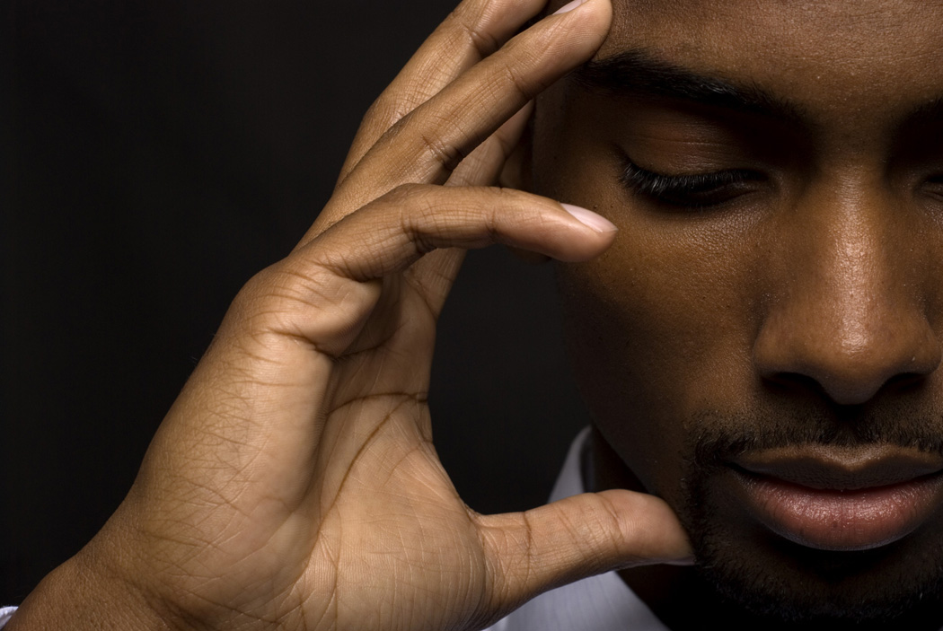
Josef
Preschooler Josef says:
“Teacher, you have a knife in your brain like I do, don’t you?”
How are you with Josef in that moment? What do you do?
Say? Not say?

Slide 33
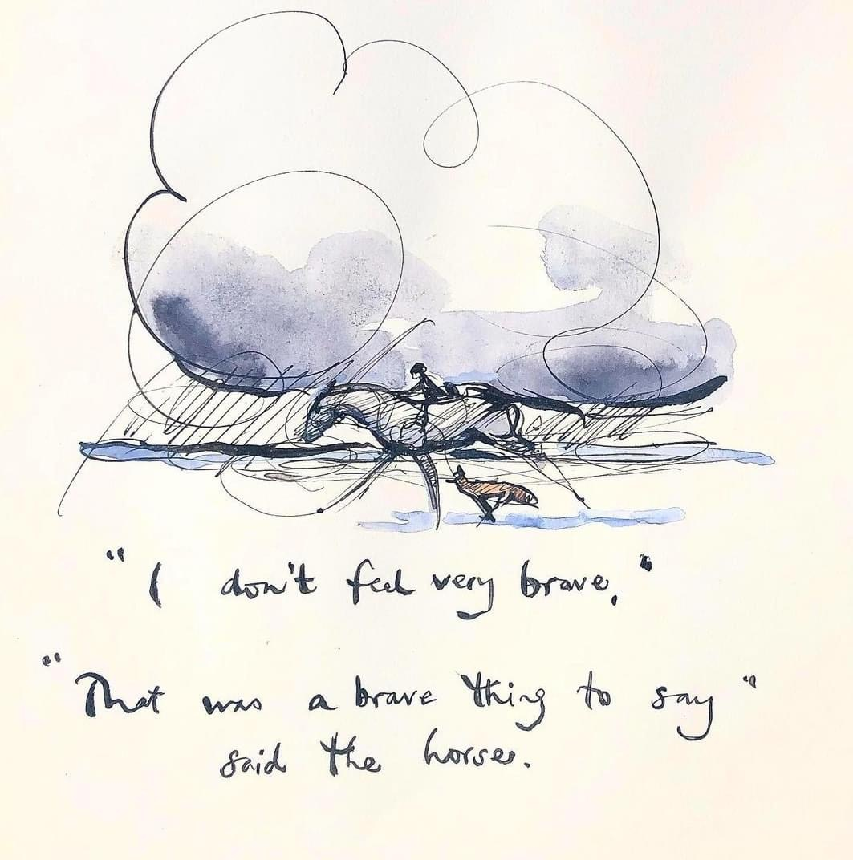

Slide 34
WHAT’S WRONG with YOU?
How many of us heard instead:
What’s wrong with you?
Can’t you do anything right?
Don’t you have a mind of your own?
You’d drive a preacher to swear/drink!

Slide 35
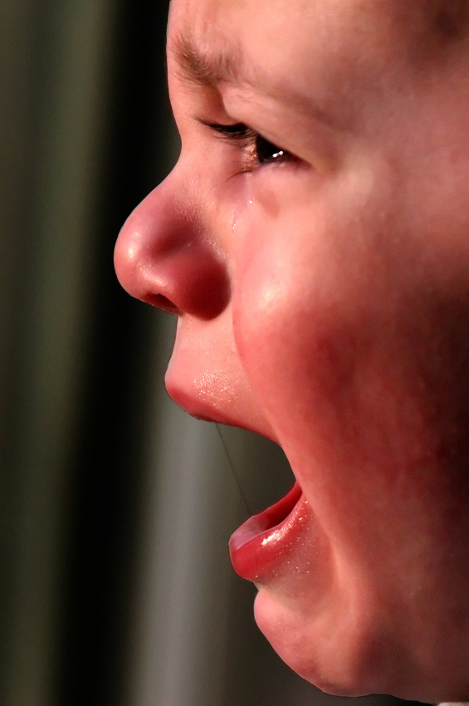
PANDEMICs TRAUMA
Trauma is one life-threatening event or ongoing series of frightening, unsafe moments that set our brains on edge with terror, producing uncomfortable behavior:
Hypervigilance
Regression
Neediness
Short tempers
Dissociation
PTSD post traumatic stress
Negativity, distrust, judgmentalism

Slide 36
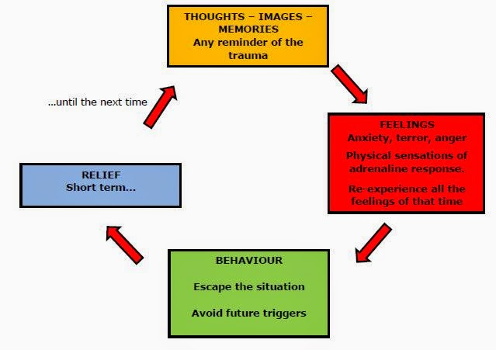

Slide 37
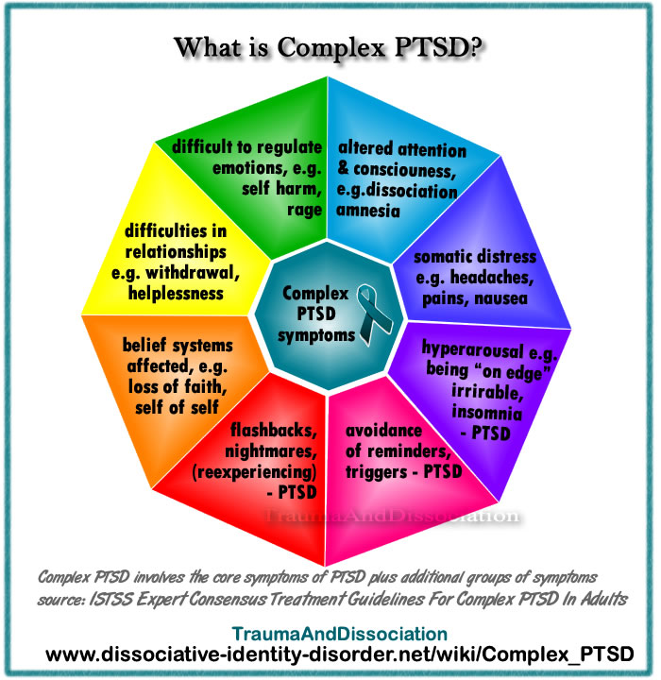
This Photo by Unknown Author is licensed under CC BY-ND

Slide 38
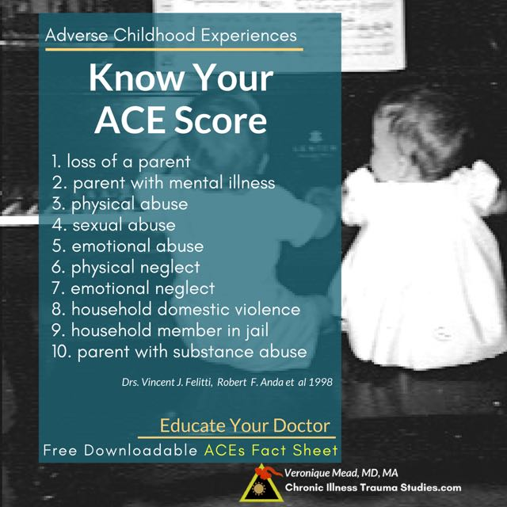
This Photo by Unknown Author is licensed under CC BY-NC-ND

Slide 39
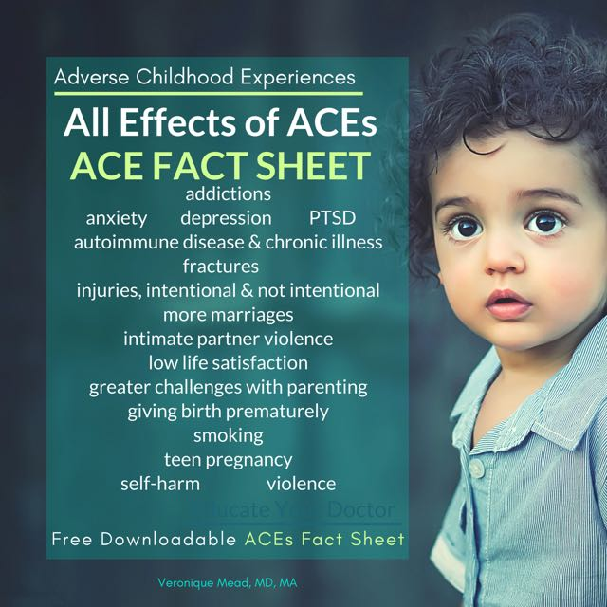
What percentage of us early childhood professionals experienced trauma in our own childhood experiences?
This Photo by Unknown Author is licensed under CC BY-NC-ND

Slide 40
What percentage of us early childhood professionals experienced trauma in our own childhood experiences?
58% unpublished research by Jackie Taylor
80-100% anecdotally across USA
This Photo by Unknown Author is licensed under CC BY-NC-ND

Slide 41
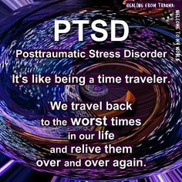
RELATIONAL SANCTUARIES heal with:
Safety
Acceptance
Unconditional Love
Playfulness
Freedom from judgmentalism
In community

Slide 42
WHAT’S RIGHT WITH YOU?
Are we meant to like ourselves?
Do children come to the earth with
positive self regard?
Were you encouraged to like yourself? Do you?

Slide 43
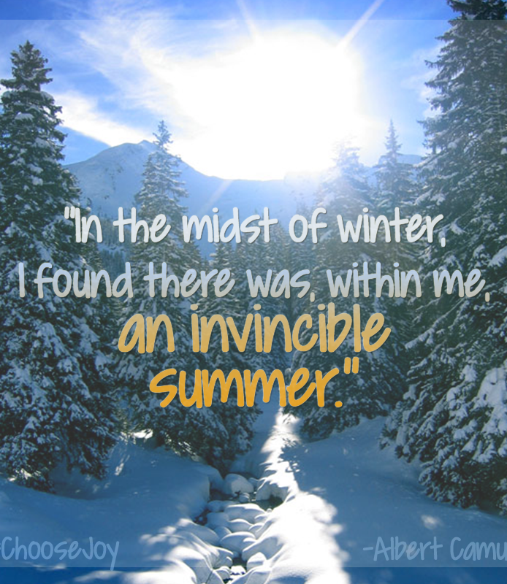
Ever since HAPPINESS heard your name
It’s been
running through
the streets
to find
you.
-Hafiz
This Photo by Unknown Author is licensed under CC BY-ND

Slide 44
How can hope triumph over fear? Esteem over self sabotage?
Remarkable Creative Capacities Challenge the illness, addiction & early death sentence overload
predicted by ACEs

Slide 45
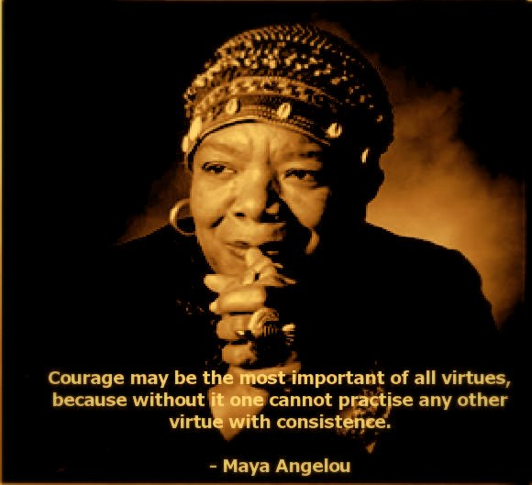
Name creative, innovative, humorous, powerful, trauma survivors who have faced their demons & made a difference
How did they break out of despair, lethargy hopelessness to become actors rather than reactors (victims)
This Photo by Unknown Author is licensed under CC BY-NC-ND

Slide 46
Share the story of one child’s Remarkable Creative Capacities that allow her/him to find her way, thrive no matter what, triumph.

Slide 47
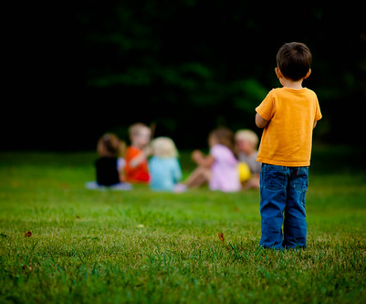
Key to resilience: child CONNECTS with one caring adult that believes in her and with whom the child feels safe and loved?
If yes, child will gradually decrease:
Self hate
Shame
Hopelessness
Isolation
Resentment
Will discover and live with
Passion
Learning to love
Empathy
Righteous anger
Eternal hope
Problem solving creativity
This Photo by Unknown Author is licensed under CC BY-SA

Slide 48
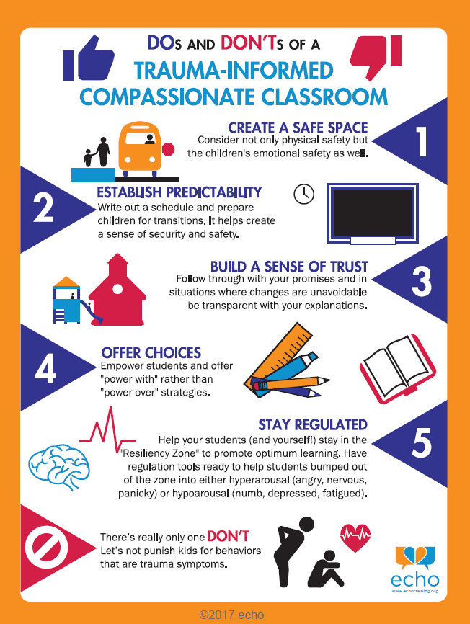
48

Slide 49
WHAT’S RIGHT WITH YOU?
Flipping the assumption of worth
in our interactions
with children and adults

Slide 50
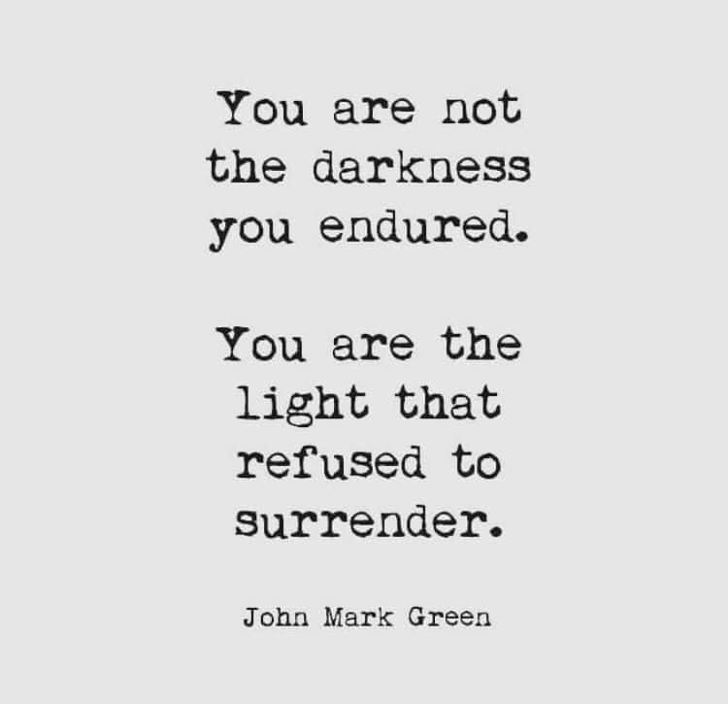

Slide 51
Case studies
What’s right with each person, yourself?
What causes us to judge people harshly?
What helps us reboot our expectations?
Costs vs benefits of opening our hearts?

Slide 52

Translating trauma into healing: claiming our remarkable creative capacities Dr. Judith Herman
What is one almost impossible obstacle you had to overcome?
You may have felt: “I can’t do this! It’s too much for me.”
But somewhere inside yourself (with or without others’ encouragement) you stepped up, risked what had to be done, took action and thrived on the other side.
Someone will believe in herself because she saw you face and triumph over your fears.

Slide 53
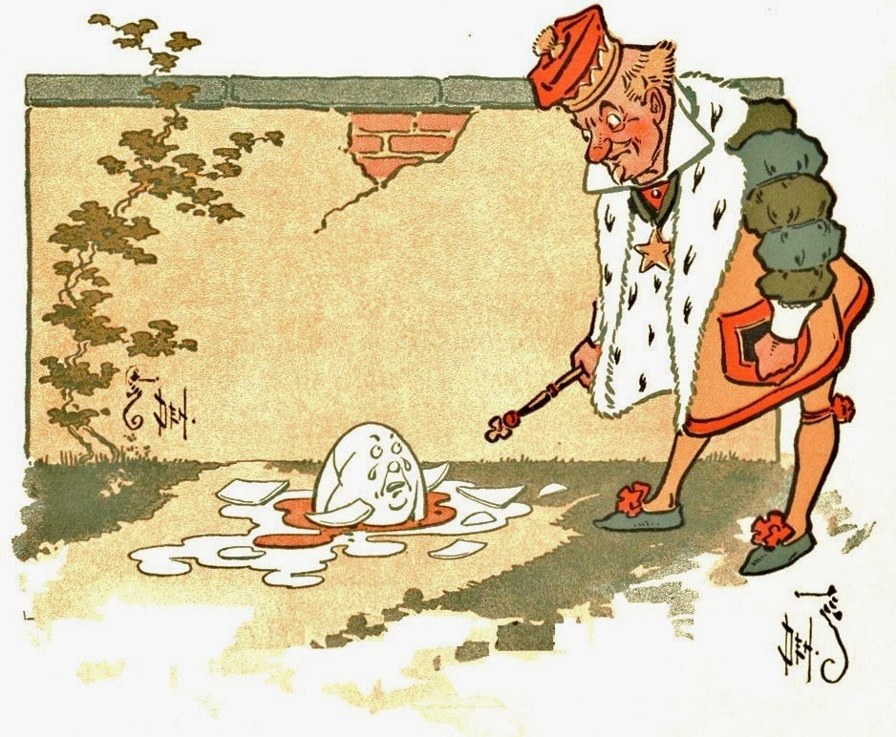
How would you rewrite HUMPTY DUMPTY?
This Photo by Unknown Author is licensed under CC BY-SA-NC

Slide 54
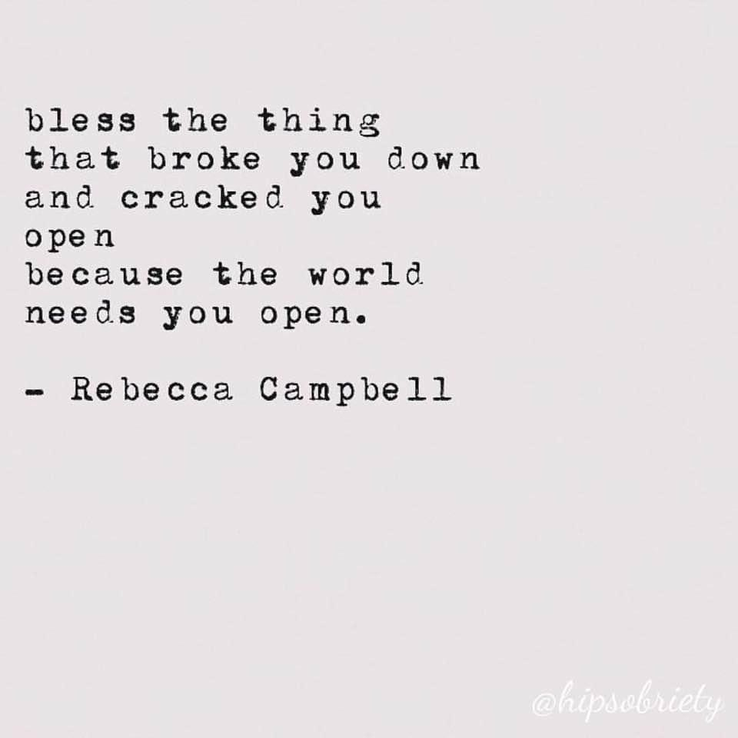

Slide 55
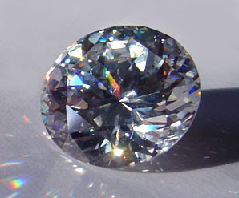
Trauma is my most rigorous guide.
Trauma is my unchosen but compelling pathway to a life of meaning, an uplifting appreciation of beauty, and a deeply anchored conviction to make the world better for every child.
Bruno, Holly Elissa. Happiness is running through the streets to find you:
Translating trauma’s harsh legacy into healing.
Exchange Press, 2020

Slide 56
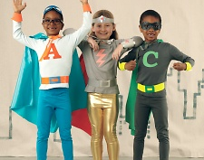
CHILDREN & ADULTS
are
SO MUCH MORE
than OUR 1-10
ACEs SCORES
www.hollyelissabruno.com
This Photo by Unknown Author is licensed under CC BY-NC-ND

Slide 57
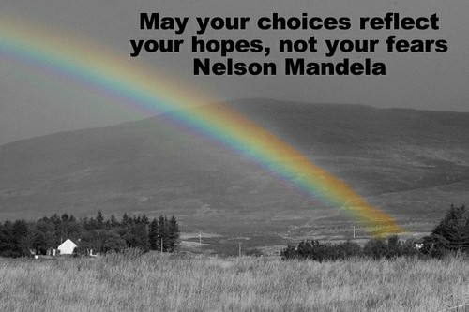
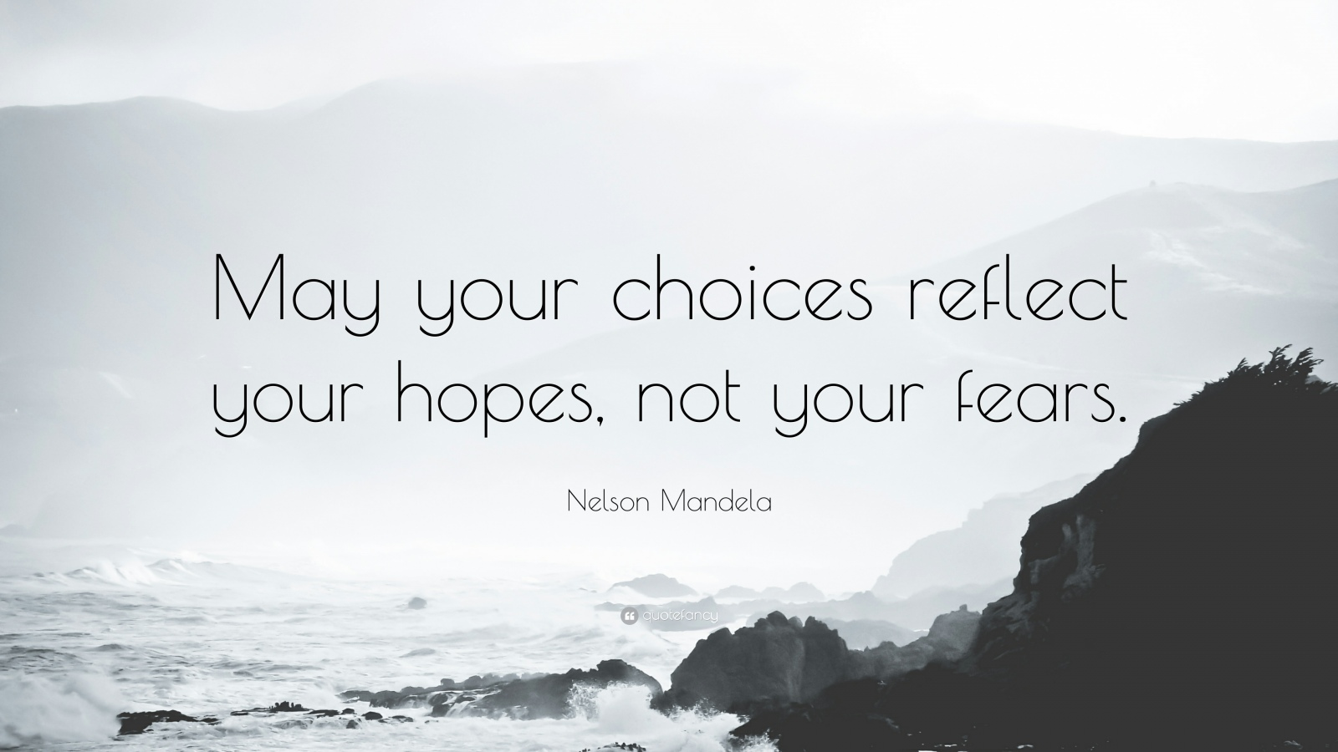
HOPE-based or FEAR-based interactions
This Photo by Unknown Author is licensed under CC BY-NC
This Photo by Unknown Author is licensed under CC BY-NC-ND
Can you choose whether to be optimistic or pessimistic?

Slide 58
Dear dedicated
TRUE
for
YOU?
This Photo by Unknown Author is licensed under CC BY-NC-ND

Slide 59
WHAT’S possible with YOU?
Flipping the our brain’s automatic fear response to hope.

Slide 60
Your expectations for yourself:
Pre-judging/Bias vs. Desire to Learn
Your behavior
How you choose to respond
You make a mistake, fail at something that matters to you
You find yourself comparing yourself to another person (rather than identifying with that person) and coming up short
You suddenly feel ashamed of yourself, inadequate, unable, immature/unworthy
You feel stuck; things are getting old and uninspiring
You conflict with another person; but, you can’t bear confrontation
Self unfulfilling prophecy____________
If you pre-judge yourself negatively, what would you say/do?
Curiosity______________
If you want to learn about yourself and your emerging choices, what can you say/do?

Slide 61
Your expectation:
Pre-judging/Bias vs. Desire to Learn
Parent behavior
How you choose
to respond
Parent holds child rather than letting child walk
Parent spoon feeds child way beyond what’s developmentally appropriate
Mom at gym, beach, nail salon, not with child
Dad does meth/opioids
That sure looks like a bruise on baby’s bottom!
Angry red streaks down toddler’s back
Bias?________________
If you pre-judge the family, what would you say/do?
Curiosity_____________
If you want to learn about the family’s ways, what can you say/do?

Slide 62
Case study: Mr. Khan, Amin & Roshon
Mr. Khan ‘s preschool son, Amin, and toddler, Roshon, are in your program. Mr. Khan tells you to treat Amin as a prince, and Roshon as an obedient housewife-to-be.
When the Khan family returns to the Middle East, Amin will serve as prince. Roshon was betrothed at birth to a man back home.
How can you partner with this family? What’s right with Mr. Khan, his family, you?

Slide 63
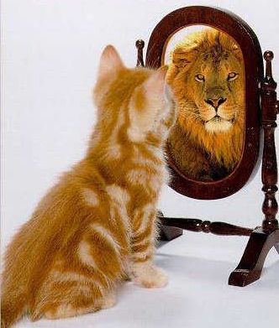
When you find yourself feeling small, doubting yourself, being hard on yourself, and others, remind yourself:
You are braver than you think, stronger than you can imagine.

Slide 64
CHOICES
Make us so MUCH MORE
than OUR
ACEs SCORES
www.hollyelissabruno.com
This Photo by Unknown Author is licensed under CC BY-NC-ND

Slide 65
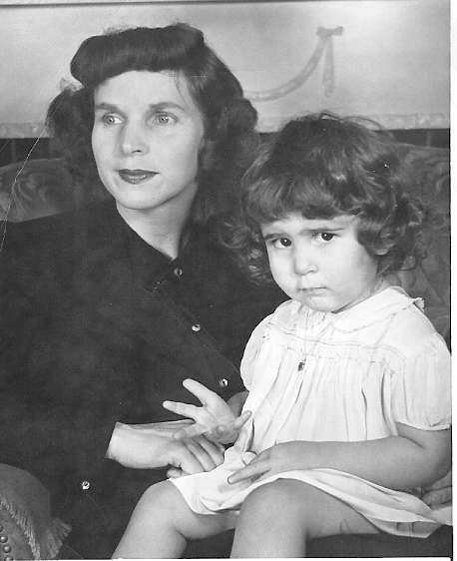
Translating trauma’s harsh legacy into healing
Become our best selves
Embrace our difficulties
Love the unlovable in ourselves & others
Connect to joy, beauty and one another

Slide 66
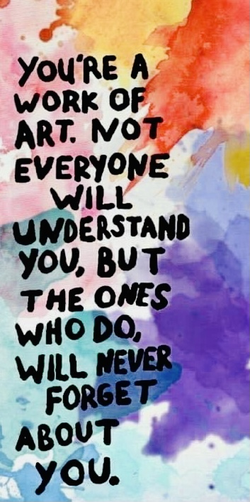

Slide 67


Slide 68
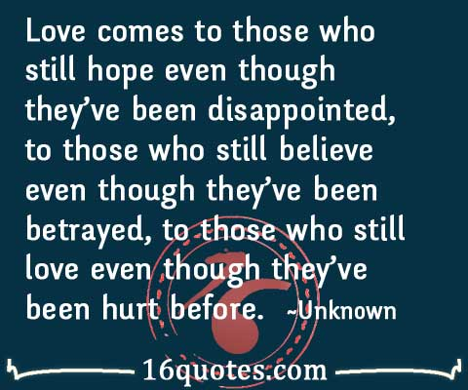
This Photo by Unknown Author is licensed under CC BY-ND

Slide 69
In closing
What touched your heart?
Challenged your brain?
Offers you hope?
Makes you laugh (especially at yourself)?

Slide 72
a. What do frightened children need most from adults? b. What do “at wits’ end” teachers and providers need most not to give up?
_____________________________
_____________________________
_____________________________

Slide 73
Case studies
What’s right with each person, yourself?
What causes us to judge people harshly?
What helps us reboot our expectations?
Costs vs benefits of opening our hearts?

Slide 76
The dark thought, the shame, the malice, meet them at the door laughing and invite them in.
Be grateful for whoever comes, because each
has been sent as a guide from beyond. -RUMI

Slide 77
Josef
Preschooler Josef says:
“Teacher, you have a knife in your brain like I do, don’t you?”
How are you with Josef in that moment? What do you do?
Say? Not say?

Slide 78
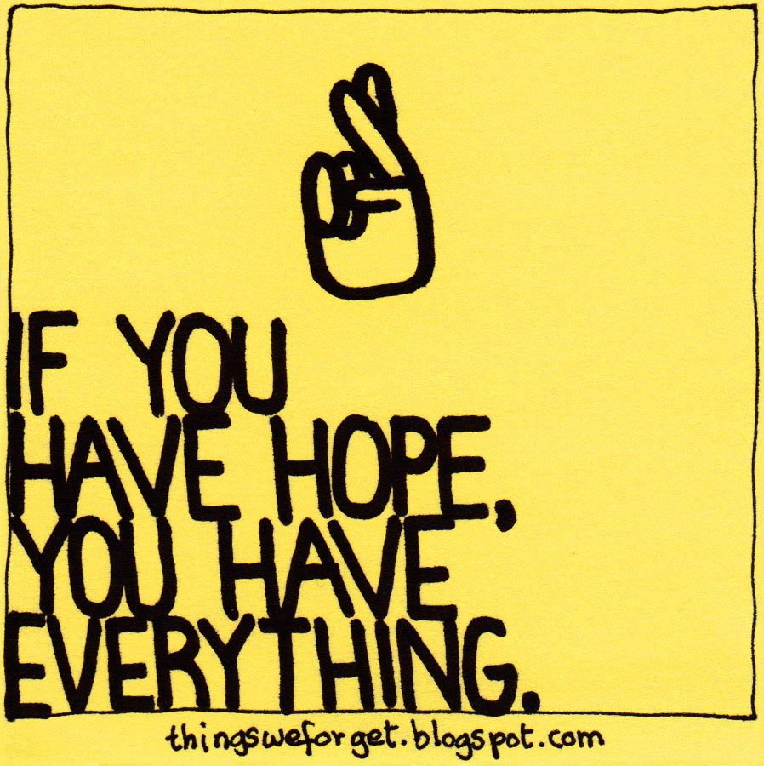
This Photo by Unknown Author is licensed under CC BY-NC-ND

Slide 79
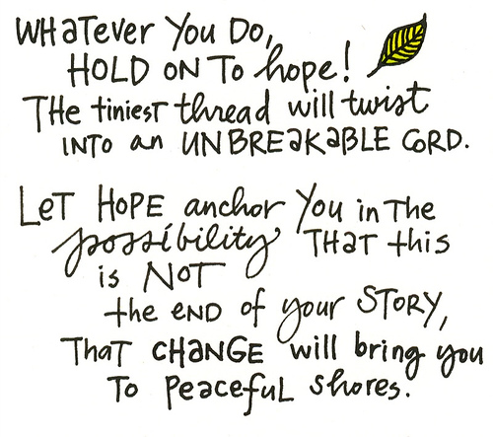
This Photo by Unknown Author is licensed under CC BY-SA-NC

Slide 80
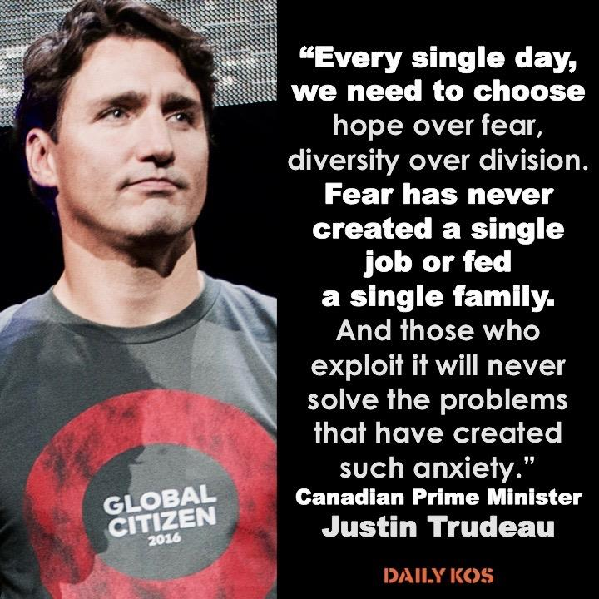
This Photo by Unknown Author is licensed under CC BY-NC-ND

Slide 81


Slide 82
resources
Bruno, H.E. Happiness is running through the streets to find you: Translating trauma’s harsh legacy into healing (2020, Exchange Press)
Bruno, H.E. Comfort of little things: An educator’s guide to second chances. (2016, Redleaf Press.
Burke, N.H. How childhood trauma affects health across a lifetime.
(2014, Tedtalks.com)
Fox, R. & Bruno, H.E. ActivechildhoodUK.
Herman, J. Trauma and recovery: The aftermath of violence from domestic abuse to political terror
(Basic Books, 1992)

Slide 83
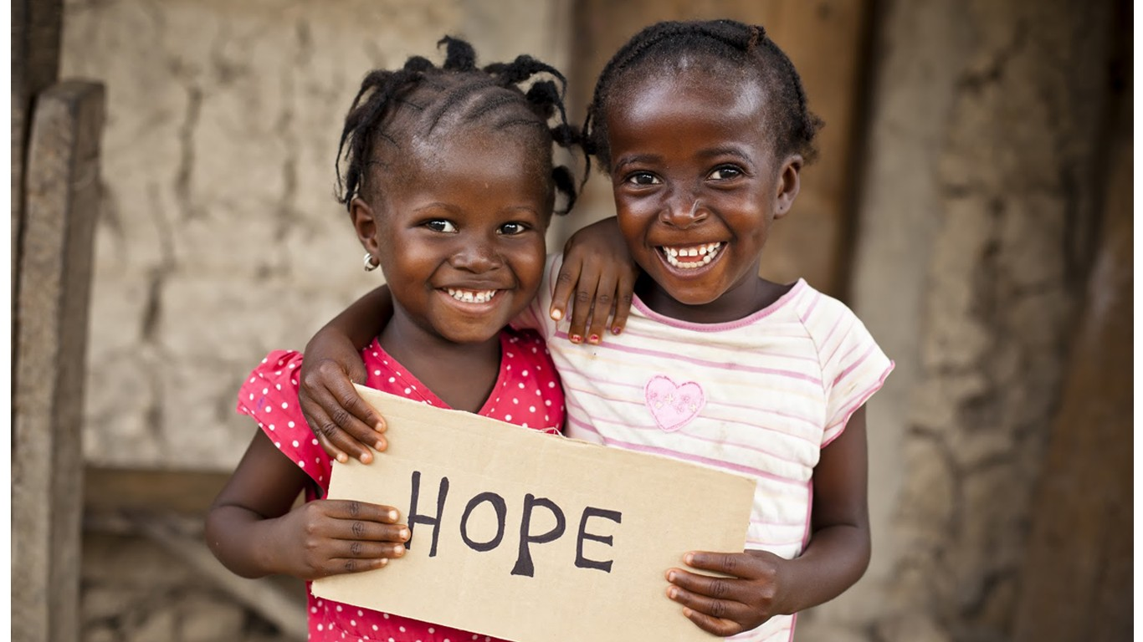
This Photo by Unknown Author is licensed under CC BY-SA

