Slide 1

KICKING GOSSIP to the CURB
CAN WE ELIMINATE GOSSIP or
WILL GOSSIP PREVAIL forever?
www.hollyelissabruno.com

Slide 2

What happens when women work with women?
How is power claimed and used?
Pandemic’s impact?af
This Photo by Unknown Author is licensed under CC BY-ND

Slide 3
SUPERVISION
For the Gentle in Spirit
Stop gossip in its tracks
Five steps to holding resistant staff accountable
Whining vs venting: Eliminating one, containing the other

Slide 4
When women work with women_______________________________________________________________.
Complete the sentence above according to your own experience.

Slide 5
KICKING GOSSIP to the CURB
CAN WE ELIMINATE GOSSIP or
WILL GOSSIP PREVAIL forever?
www.hollyelissabruno.com

Slide 6
GOSSIP:
Talking about another person who is not present,
With the intention to harm the other person’s reputation.
Listening to gossip is gossiping.

Slide 7
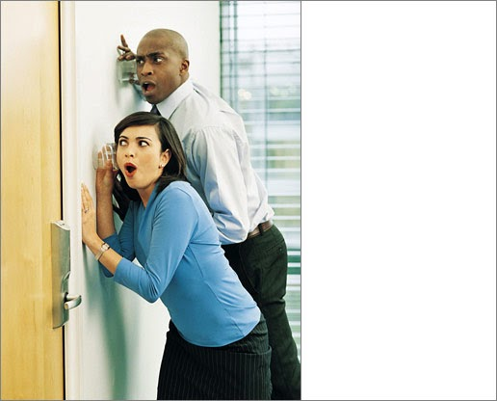
What is the APPEAL OF GOSSIP?
WHY do we GOSSIP?
WHAT’S IN IT for US?
This Photo by Unknown Author is licensed under CC BY

Slide 8

This Photo by Unknown Author is licensed under CC BY-NC-ND

Slide 9

SAFEGUARDS for your BOUNDARIES
You get to choose
whether/how much
to participate
You can:
Pass
Count on Confidentiality
Take care of yourself
Reach out to talk one on one with a Warm Line counselor at:
907.452.4357
RESPECT

Slide 10
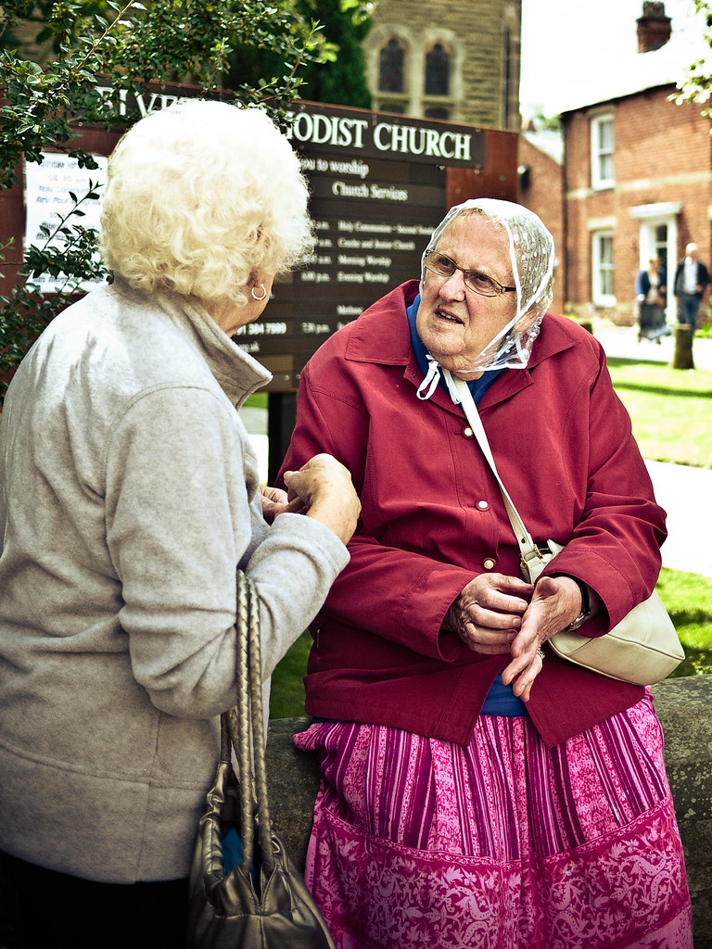
What’s the PURPOSE of GOSSIP?
This Photo by Unknown Author is licensed under CC BY-NC-ND
DOES GOSSIP HAVE ANY BENEFITS?
WHAT HARM DOES GOSSIP CAUSE
INDIVIDUALS & THE GROUP?

Slide 11
Gossip & fear of conflict
70% of women take things personally
44% of men prefer harmony to conflict
When men have conflicts, they fight it out and move on
Women forgive but don’t forget
Remember Q-TIP: Quit Taking It Personally!

Slide 12
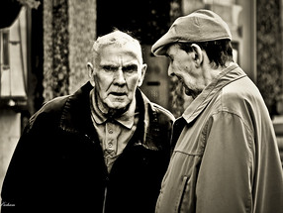
WHO’S GOT THE POWER?
This Photo by Unknown Author is licensed under CC BY-ND
GOSSIP DIVIDES US INTO INSIDERS & OUTSIDERS
WHICH WOUD YOU RATHER BE?

Slide 13
WHY do we GOSSIP?
TO HAVE POWER
BE IN CHARGE
GET WHAT WE WANT
TO EXCLUDE OTHERS
TO BULLY PEOPLE
HARM A PERSON’S REPUTATION
FEEL SUPERIOR
1 WE’RE AFRAID
2. NEED CONTROL
3. CAN’T TOLERATE DIFFERENCES
4. ARE HURTING
5. NEED TO GET EVEN.
_______________

Slide 14


Slide 15
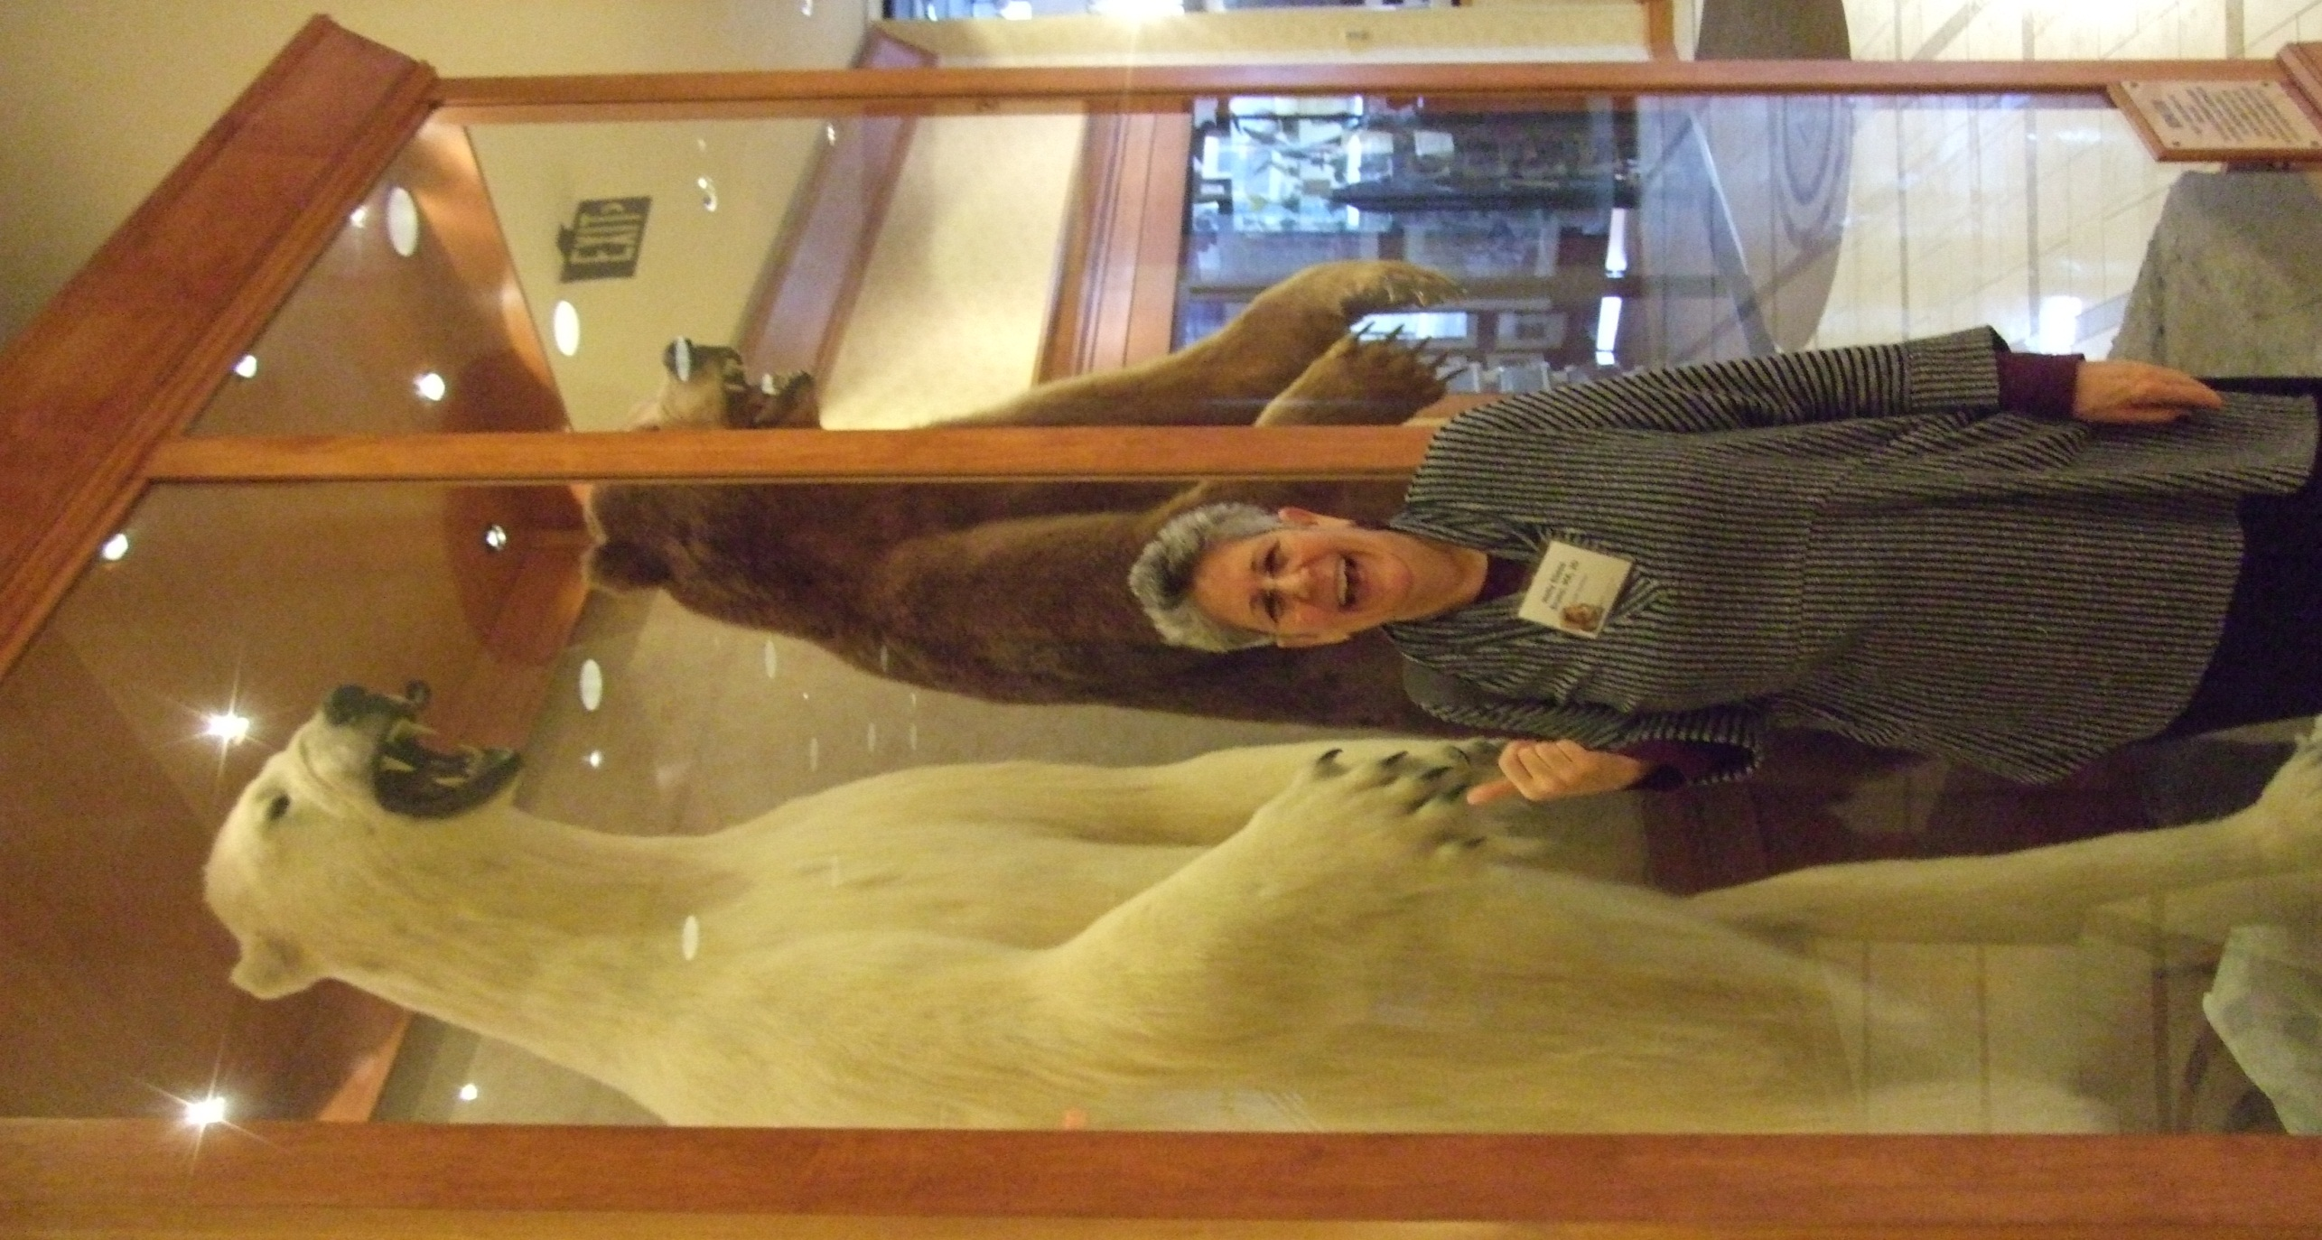
You gain strength, courage and confidence by every experience in which you stop to look fear in the face
You must do the thing you think you cannot do.
-Eleanor Roosevelt

Slide 16

How old are little girls when they start gossiping?

Slide 17
How old are little girls when they start gossiping?
Four year old little girls are already forming exclusive cliques
=NY Times

Slide 18
“I’m not going to play with Madison for 100 years, are you?”

Slide 19

Imagine you are about to confront someone you are afraid to confront.
Gossiping is so much less scary that
actually facing the person directly.

Slide 20

Imagine you are going to confront someone who pushes your buttons, that you don’t like.
Draw a picture of what you feel like (or your state of mind) just before you confront her/him.

Slide 21

Confrontation can feel:
Awkward
Uncomfortable
Embarrassing
Exhausting
SCARY
IMPOSSIBLE!

Slide 22
This Photo by Unknown Author is licensed under CC BY-NC-ND

Slide 23


Slide 24
WHAT CAN a PEER SAY to a GOSSIPER
That will
STOP GOSSIP
In itsTRACKS?

Slide 25
Gossip stoppers
TO STOP GOSSIP IN ITS TRACKS
I need to focus on the children right now.
I am not comfortable talking about a person who is not present.
Let’s not go there.
I promised not to gossip (gave it up for lent)
Would you be willing to talk with X about your problem with her?
I’ll go with you so you can share your concern with X.
I don’t want children to witness and learn gossip.
Since I can’t help you with that problem, please don’t bring it to me again.

Slide 26
AGREEMENT TO RESOLVE CONFLICTS
I, ________, an employee of _________, agree to promptly and directly raise any issue I have with another staff member with her.
I agree to work with my colleague to find a mutually agreeable solution that builds on both our strengths.
If, after a good-faith effort, the conflict remains unresolved, I will request a meeting with my director (or designee) and my colleague to resolve the conflict.
I agree to take to that meeting at least two possible solutions that honor the needs of the organization and both people.
I agree to neither gossip about, nor hold back from, resolving an issue that affects the quality of care and education our organizations offers.
I will fully participate in staff development sessions on problem-solving techniques.
____________________________ ____________
Signature & printed name Date

Slide 27
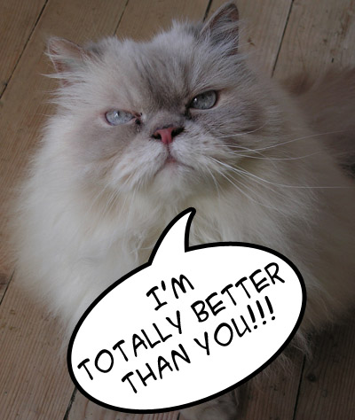

Slide 28
Problem solving to prevent power struggles
What shall we model for children?
Call the 2 people together
Tell them the purpose is to problem solve together
If a child were sitting here, what would you want her to witness?
Tell me what you experienced (equal time for shares)
Focus on yourself
Listen to learn what other person experienced
Identify underlying issue: What broke?
What solutions build on strengths?
Agree on a solution that ensures ongoing direct communication

Slide 29
Case study: Gabriella & Maude
Team teachers, Gabriella & Maude, dislike one another. They gossip and complain to other teachers. Gabriella, a free spirit, is spontaneous and fun-loving. Maude believes children can only learn from structured, well-organized lesson plans.
Gabriella, inspired by a frog on the playground, has children finger paint frog ponds. In a rush to leave for her 2nd job, Gabriella tells children to spread their paintings around the edge of the room to dry. She leaves without a word to Maude.
Maude, fearful someone will slip and get hurt, throws the wet papers out. “Another law suit prevented”, Maude reasons.
You are called in the next morning to help the team teachers problem solve. What steps do you take?

Slide 30
Venting: helpful or harmful?

Slide 31
For venting to be helpful
Vent to an appropriate person
Limit the time (3-5 mins)
If venting continues, take action on the underlying problem

Slide 32
How to stop whiners
Brinkman & Kirshner, Dealing with people you can’t stand
Do not:
Agree with the whiner
Disagree with the whiner
Solve the whiner’s problem for her.
Do:
Interrupt politely
Say: Let’s problem solve
Ask: Is there anything you want to tell me about why you are down so often?*
If s/he refuses to problem solve, say: Since I can’t help you with that problem, please don’t bring it to me again.

Slide 33
Jasmine, Preschool Teacher
Work day begins at 6:30 am
Been late for weeks despite coaching
Monday arrived at 7:15 am
Tuesday at 8:05
Today shows up at 9
Argues she can get a $$ job anywhere
Doesn’t see a problem; blames others

Slide 34
Five principles of effective confrontation
Focus on behavior, not personality
Be factual and concrete
Know what you stand for: Keep your eyes on that prize
Don’t get “hooked” into power struggles: Q-TIP
Expect adults to take responsibility for themselves.

Slide 35
Five steps to effective confrontation
Name inappropriate behavior
State what is expected
Ask: “What will you do to correct this?”
PERSIST until a solution is identified and agreed upon
Make a clear plan for follow-up, including notification of consequences if behavior does not change.

Slide 36

Separate past pain/anger from the present
If you’re hysterical,
it’s historical!

Slide 37
Overlaying Past Unresolved Troubles on Today’s Simple Conflicts
CONFLATION
When a problem triggers a seismic reaction, step back
Ask: Am I replaying an old battle?
Separate the past as best you can
Deal with today’s issue only

Slide 38
Nobody else can live the life you live.
And, even though no human being is perfect,
We always have the chance to bring what’s unique about us to life.
Fred Rogers

Slide 39
The only person who likes change?
A baby with a wet diaper.

Slide 40
The toughest thing is to love somebody who has done something mean to you, especially when that somebody is yourself.
Look inside yourself and find that loving part of you. Take good care of that part because it helps you love your neighbor.
-Fred Rogers

