Slide 1
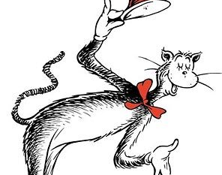
Alaska ECE professionals hats off to you.
THANK YOU
for MAKING the WORLD
a BETTER PLACE
ONE CHILD & FAMILY
at a time during dark times especially.
This Photo by Unknown Author is licensed under CC BY-NC

Slide 2
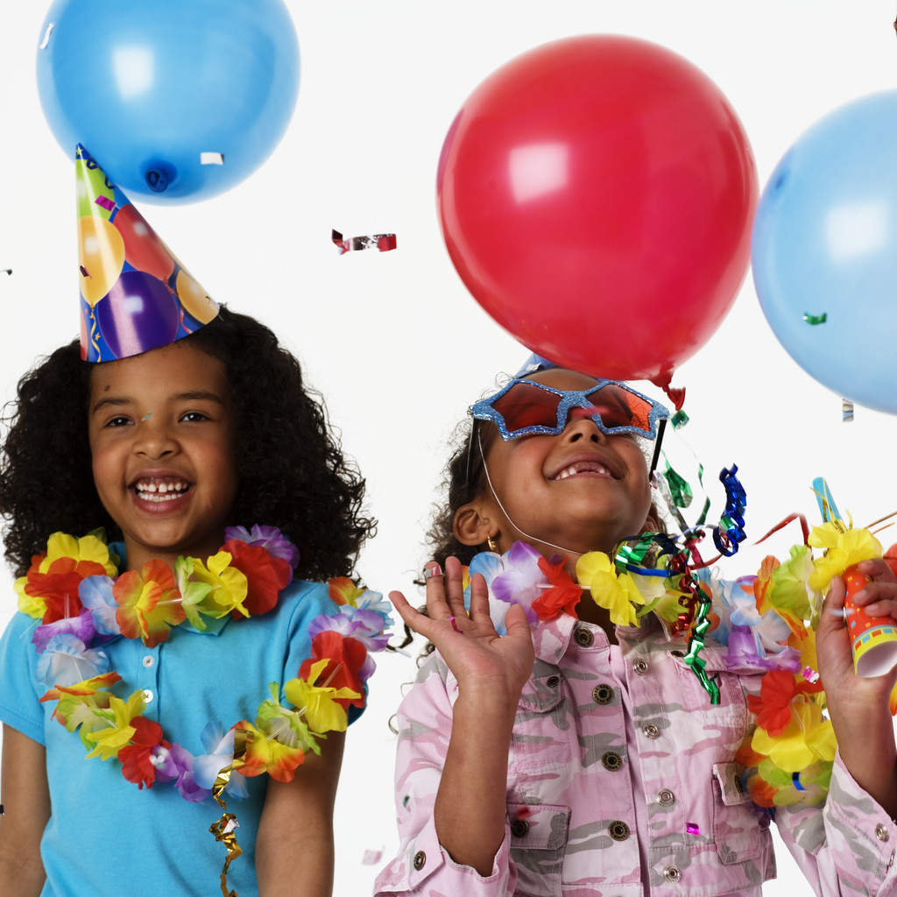
Dear dedicated
Dear dedicated
Anchorage AEYC professionals
YOU’VE BOUNCED BACK through HARD TIMES, LOSSES, & SEPARATION from PEOPLE YOU LOVE,
Even in the darkest of times, we can find the best in ourselves to share with others. Aim to reclaim Happiness!

Slide 3
What frightened children need from adults
At many times throughout their lives children will feel the world has turned topsy-turvy.
It’s not the ever-present smile that will help them feel secure.
It’s knowing that love can hold many feelings, including sadness, and that they can count on the people they love to be with them until the world turns right side up again.
-Fred Rogers

Slide 4
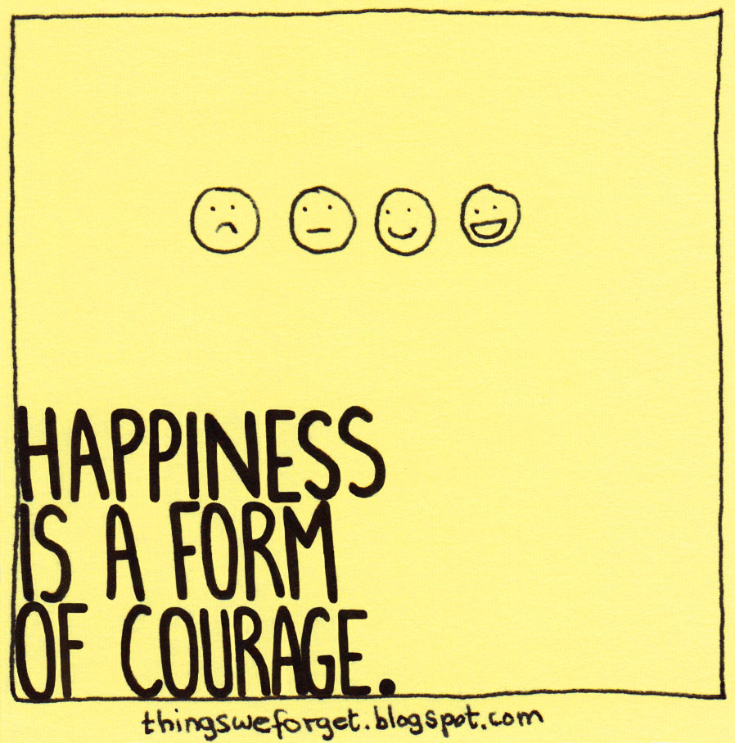
To BOUNCE BACK from giving up , WHAT:
Do you need?
Do you say to yourself? Do?
Is your BOUNCE BACK STRATEGY?
This Photo by Unknown Author is licensed under CC BY-NC-ND

Slide 5
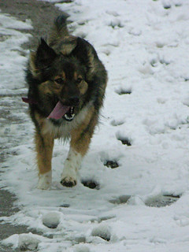
Are you
READY?
Hair toss
Check my nails
Baby, how you feeling?
This Photo by Unknown Author is licensed under CC BY-SA-NC
This Photo by Unknown Author is licensed underC BY-SA

Slide 6
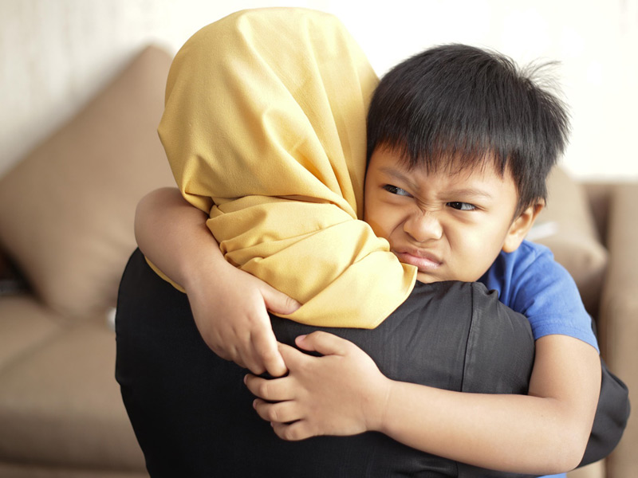
I’m NOBODY, he says, when asked his name. How do you help him?

Slide 7

SAFEGUARDs & Boundaries
You can:
Pass
Expect confidentiality
Get warm Line support 907.452.4357
C.R.A.F.T.
RESPECT

Slide 8
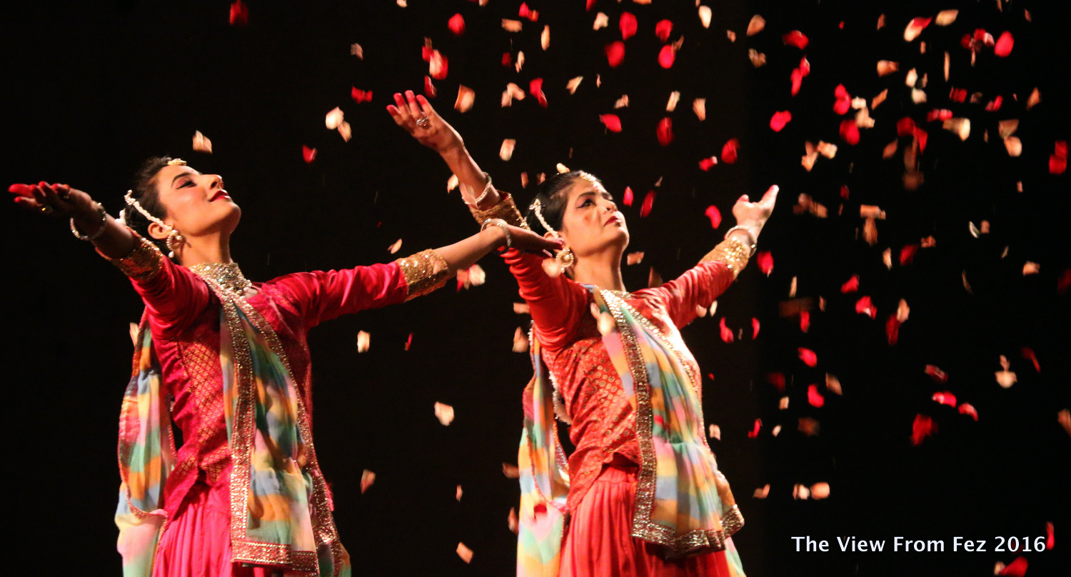
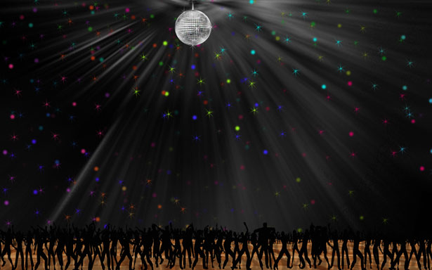
What helps you choose HOPE over FEAR?
HOPE heals our weary souls
FEAR steals our birthright to joy
HIGH TIME TO STEP UP & HELP OUT our attitudes
This Photo by Unknown Author is licensed under CC BY-SA

Slide 9
To BOUNCE BACK from giving up , WHAT:
Do you need?
Do you say to yourself? Do?
Is your BOUNCE BACK STRATEGY?
BOUN
This Photo by Unknown Author is licensed under CC BY-NC-ND

Slide 10

Choosing hope over despair: What choice do we have?
What is one almost impossible obstacle you had to overcome?
Maybe you felt: “I can’t do this! It’s too much for me.”
But somewhere inside yourself (with or without others’ encouragement) you stepped up, risked what had to be done, took action, found your way hope and thrived on the other side.
Someone will believe in herself because she saw you face and triumph over your fears.

Slide 11
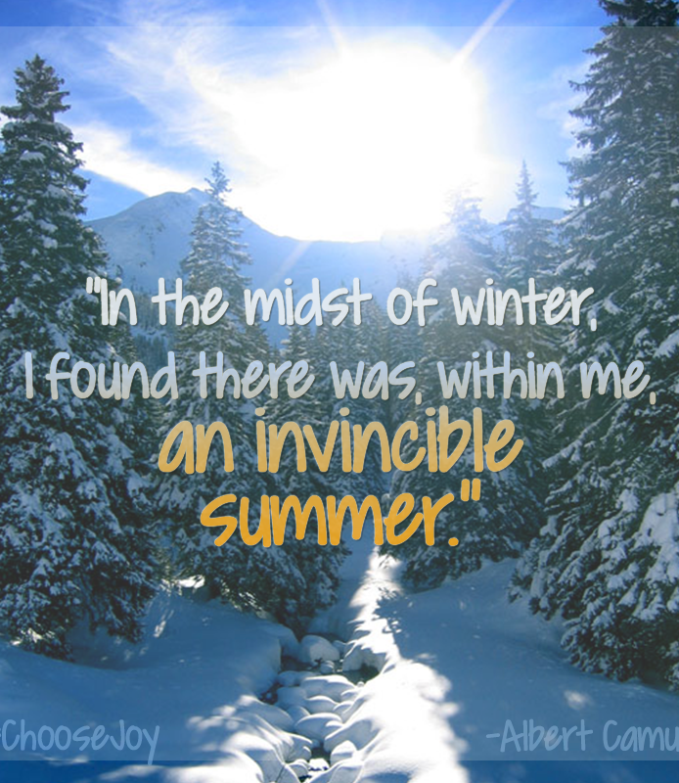
Ever since HAPPINESS heard your name
It’s been
running through
the streets
to find
you.
-Hafiz
This Photo by Unknown Author is licensed under CC BY-ND

Slide 12
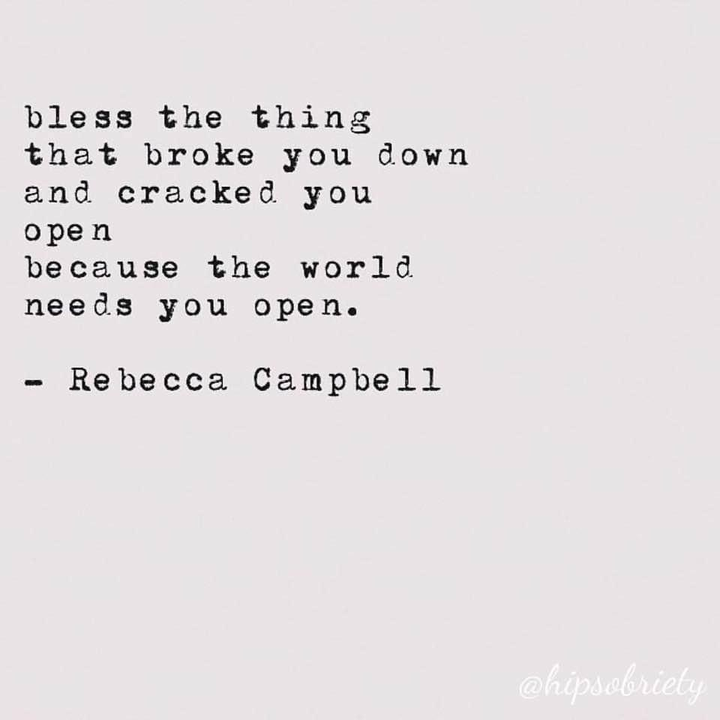

Slide 13
I’m NOBODY, he says, when asked his name. How do you help him?

Slide 14
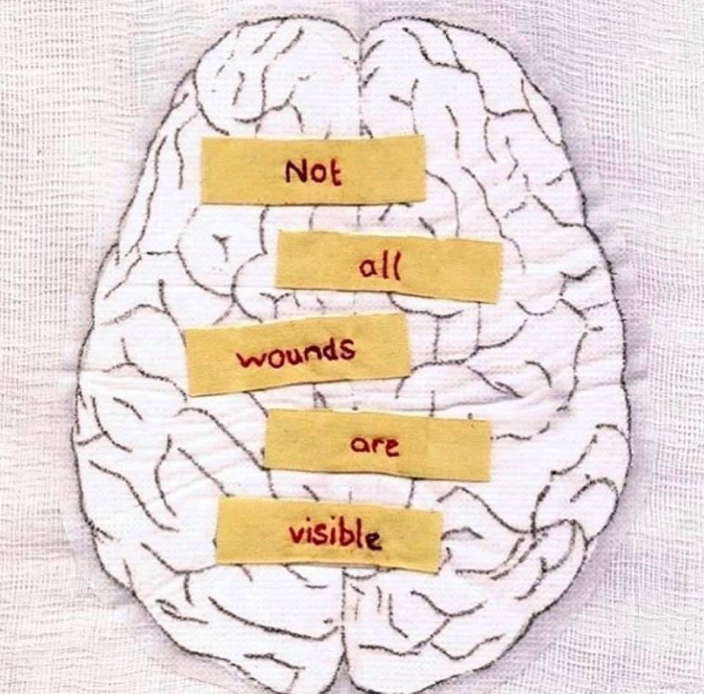

Slide 15
BRAIN MATTERS
How does our brain help us bounce back or keep us stuck in the endless fear cycle?
What choices can we make to re-set our brains for resilience rather than give in to hopelessness?

Slide 16
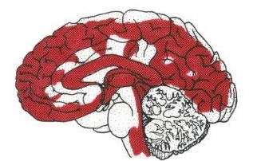
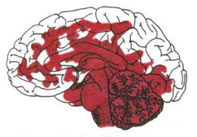
hope reframes fear, SHAME drain
OUR BRAINS
HOPE-Based
ACTOR believes in possibilities
FEAR-Based
REACTOR dreads harsh judgment
Blood pumps evenly to all parts of brain, fueling all functions, flowing to pre-frontal cortex Executive Function for perspective, creativity, innovation, optimism, clarity, HOPE.
Blood pools in amygdala, triggering “flight or fight; freeze or fawn, float” response, robbing Executive Function by up to 95% of capacity to problem solve,
stay professional. Autonomic response feels
out-of-control, panicky, can’t “think straight”.

Slide 17
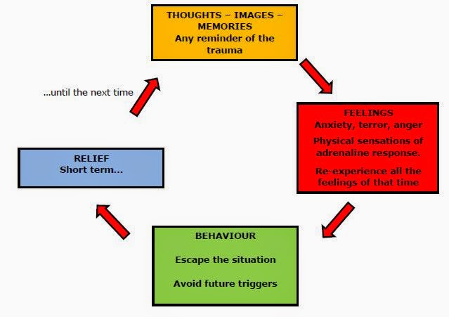

Slide 18
FEAR-Based amygdala
Pumps adrenalin/cortisol to keep us from dying
How do we leap from an Amygdala Hijack into the freedom, intuitive wisdom of our Executive Function?

Slide 19
To run on all cylanders
SWITCH OVER TO, PUMP UP
Your Executive Function
RE-SET YOUR BRAIN from dread to HOPE, powerless to courageous

Slide 20

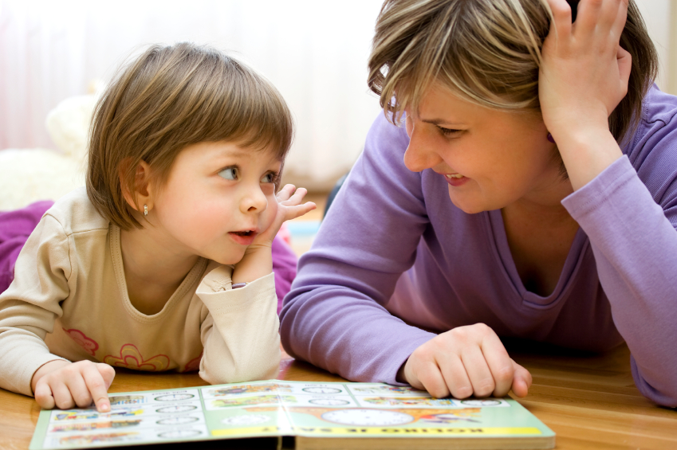
RESILIENCE: Every child deserves one adult who believes that child is the most marvelous, gifted, loveable person on earth. WV ECE Director

Slide 21
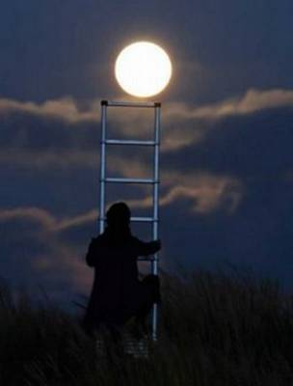
SIMPLE THINGS
Sing
Dance
Give back
Be in nature
Connect heart to heart
Accept don’t judge
Seek the gifts, treasures
Out beyond ideas
of wrong doing
and
right doing
there is a field.
I’ll meet you there.
-Rumi

Slide 22
Name three adult behaviors that
PUSH your BUTTONs;
One child behavior that gets you.
Give examples of when you:
Let your buttons get pushed
Intervened with a QTIP to Quit Taking it Personally or used another strategy
This Photo by Unknown Author is licensed under CC BY-NC

Slide 23
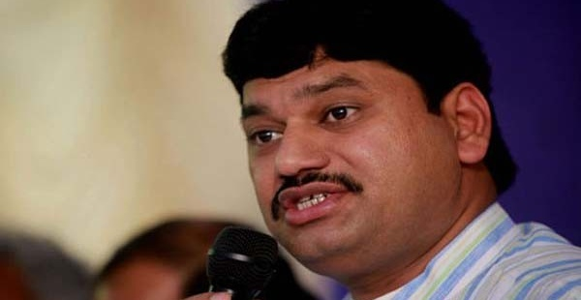
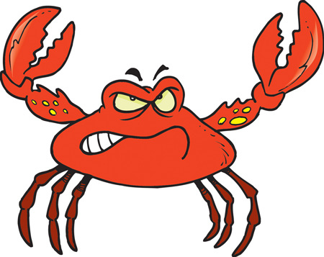
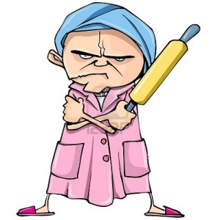
What makes us crabby despairing, guit?
This Photo by Unknown Author is licensed under CC BY-SA-NC

Slide 24
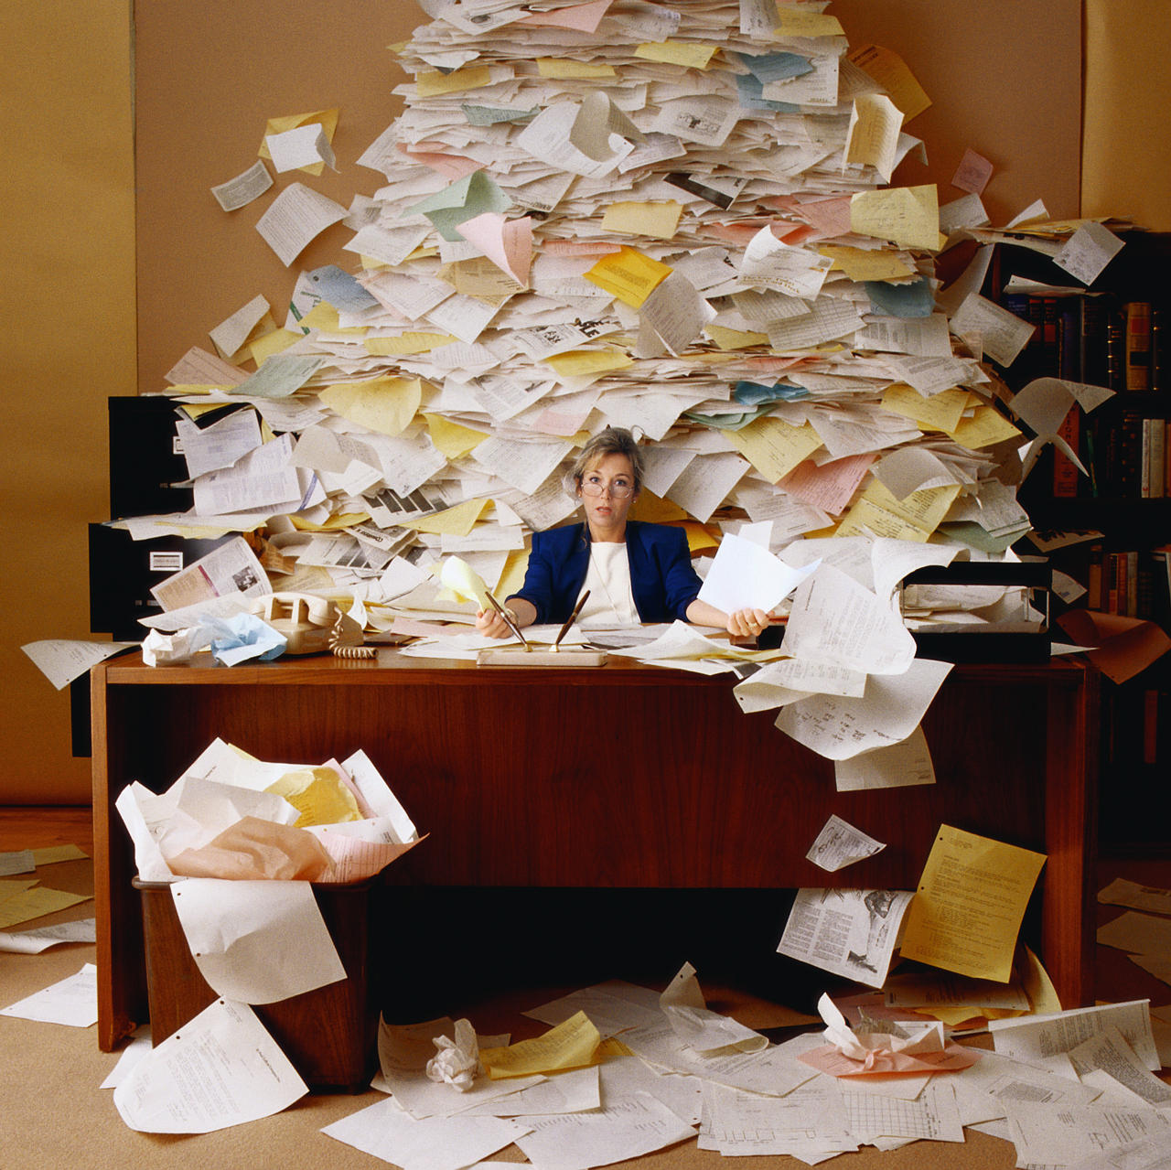

Slide 25
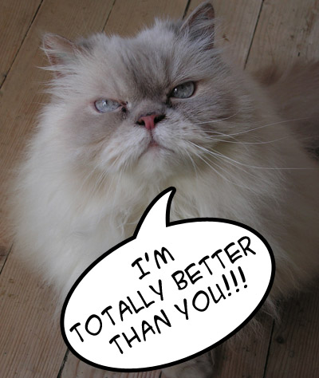

Slide 26
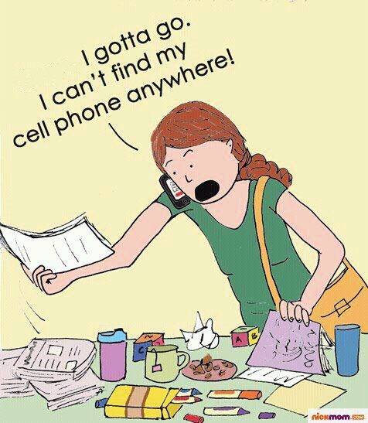

Slide 27


Slide 28
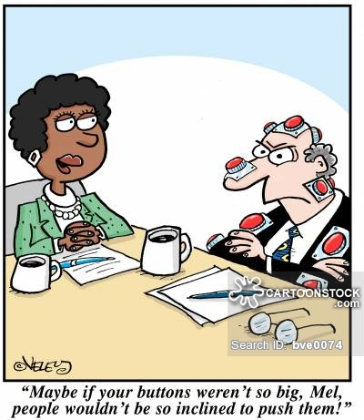

Slide 29
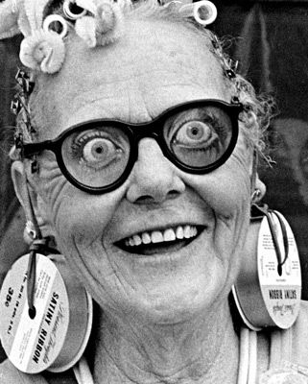
Some BEHAVIORS drive up cray-cray.
How skilled are you at not letting people get under you skin? 1-Not…..5-ok…..10-FAB

Slide 30
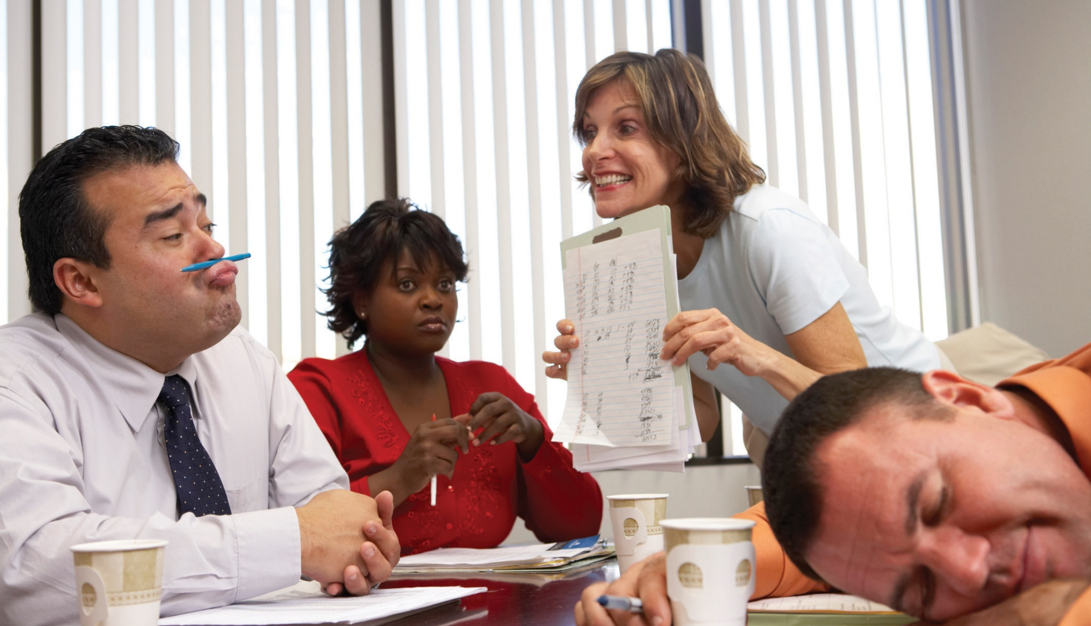
s
Adults behaving like children

Slide 31
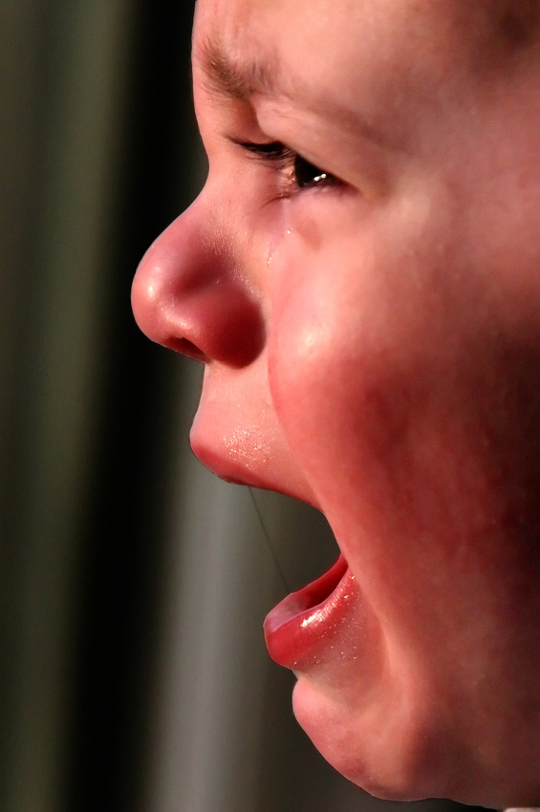
Locked into Fear or anger, we can’t fathom being free
A series of traumatizing experiences or one life-threatening event of loss, shame, abandonment, terror produces:
Hypervigilance
Regression
Neediness
Short tempers
Dissociation
(C)PTSD post traumatic stress
Negativity, distrust, judgmentalism

Slide 32
LOCKED in anger, fear, victimhood, our brains can only keep us alive; they cannot help us see or choose possibilities.

Slide 33
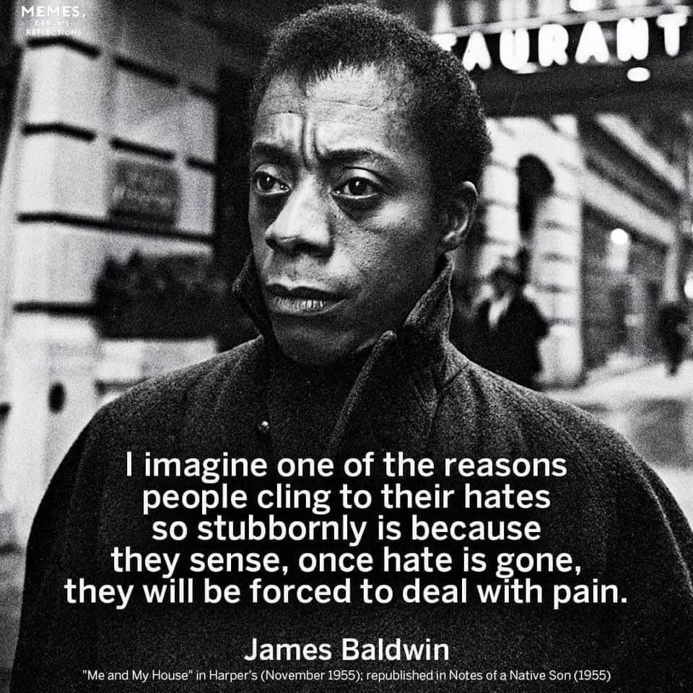

Slide 34
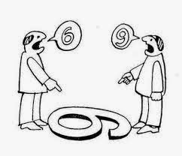
Recall a: 1) stand-off & 2) break-through with a child, parent, team mate
What happened?
Who said and did what?
What might you learn from each of these experiences?

Slide 35
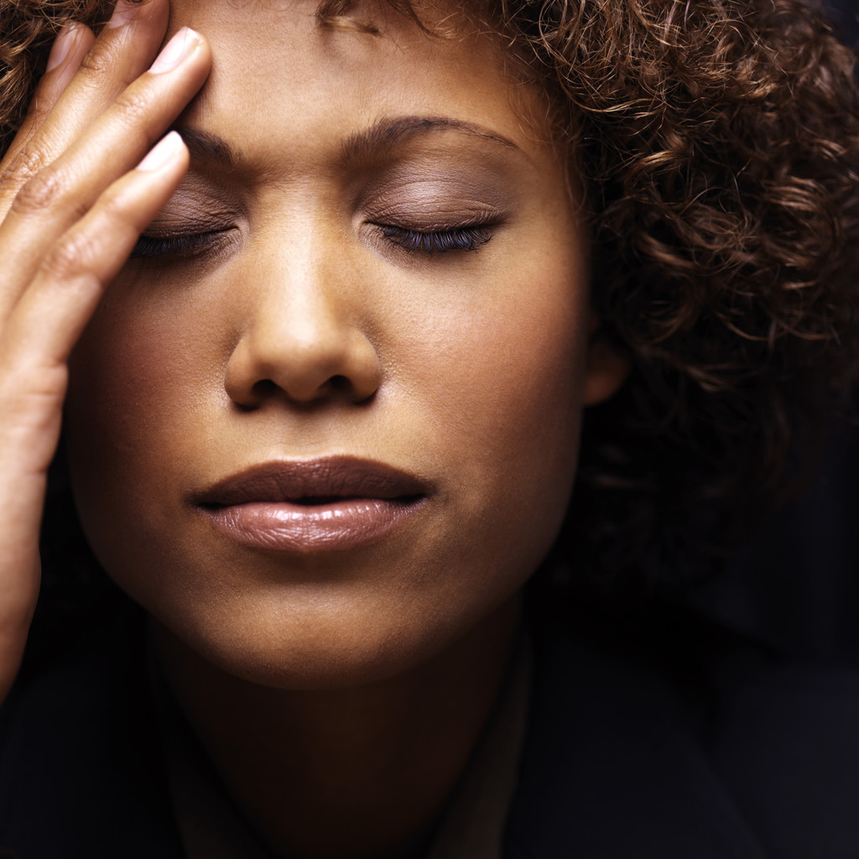

Slide 36
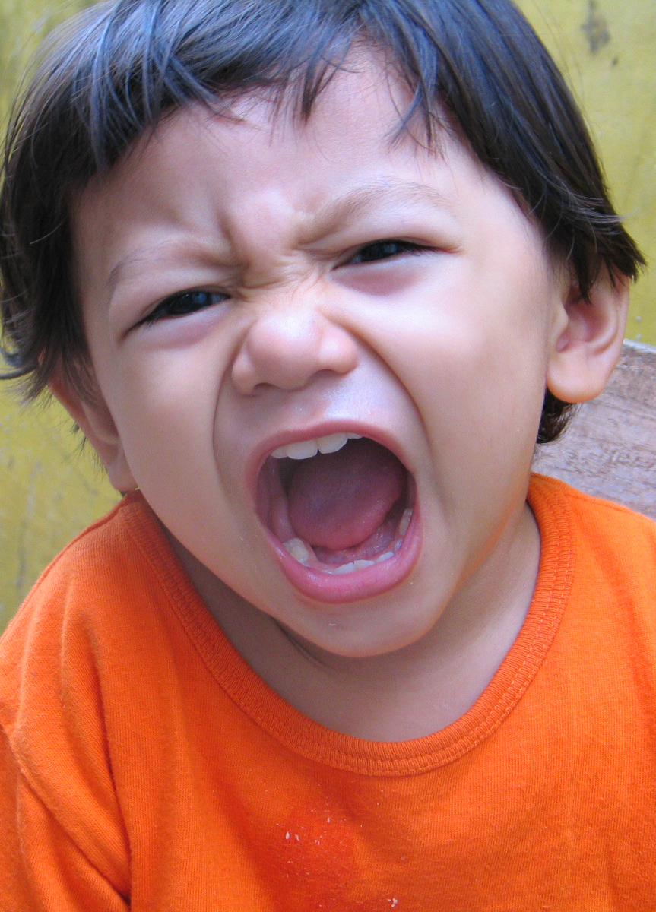
I hate my Mommy/Daddies!
Can you take me home with you, teacher?
.

Slide 37
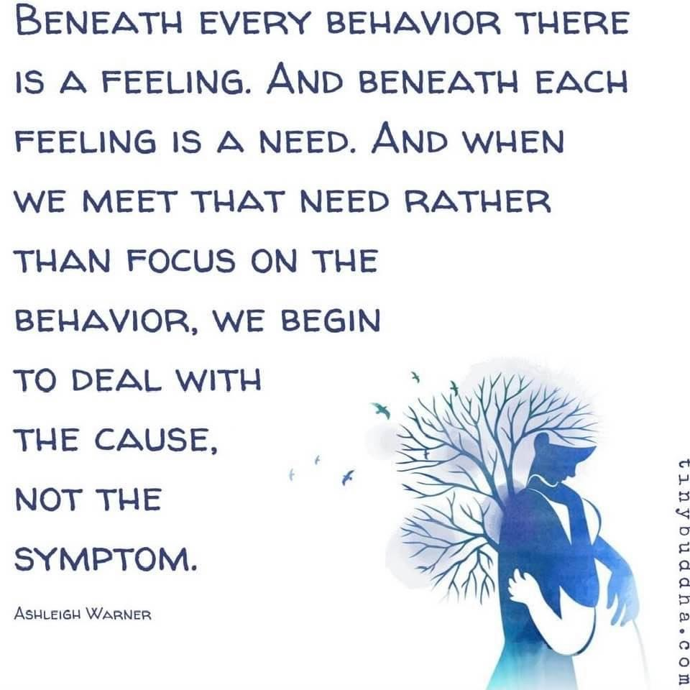

Slide 38
Name three adult behaviors that PUSH your BUTTONs.
One child behavior that gets you.
Now, identify 3 actions that help you stay sane, equitable, loving, wise
This Photo by Unknown Author is licensed under CC BY-NC

Slide 39
HAPPINESS is running through the streets to find YOU
To REVERSE
Traumatization
In the moment
This Photo by Unknown Author is licensed under CC BY-NC

Slide 40
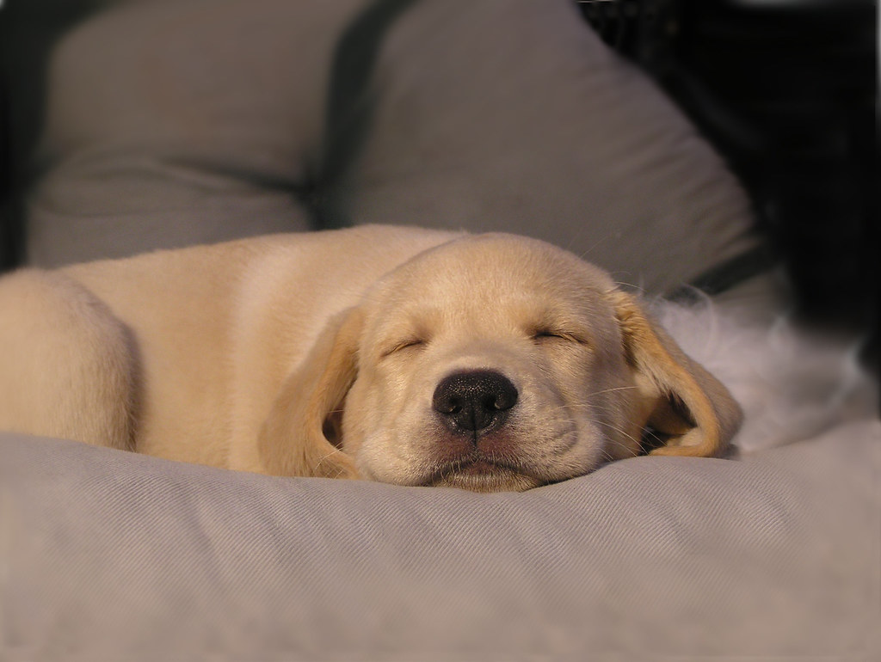
WHAT do ANXIOUS CHILDREN
NEED MOST to be able to LEARN & THRIVE?
This Photo by Unknown Author is licensed under CC BY-SA

Slide 41
Safety
-Dr. John Medina,
ACEs study author
This Photo by Unknown Author is licensed under CC BY-SA

Slide 42
“When people are able to find that sense of PLAY in their work, they truly become powerful figures”
Stuart Brown, MD

Slide 43
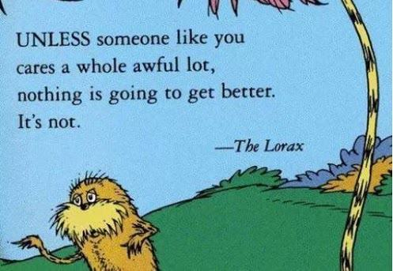
This Photo by Unknown Author is licensed under CC BY-SA-NC

Slide 44
How do we recalibrate negativity?
Humor, Laughter, Play
Trigger prefrontal cortex or executive function activity
Our prefrontal cortex is the locus of new ideas, problem solving acumen, humor, generosity, optimism & vision for a better future.

Slide 45
Play is the brain’s jungle-gym
Play selectively stimulates nerve growth:
In the amygdala, where emotions are processed; and,
In the dorsolateral prefrontal cortex where executive decisions are processed
-Jan Panskeep, neuroscientist

Slide 46
“When people are able to find that sense of PLAY in their work, they truly become powerful figures”
Stuart Brown, MD

Slide 47
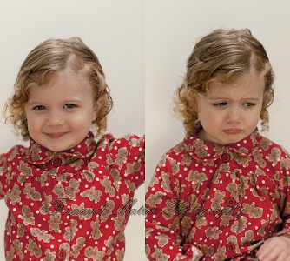
The last of the human freedoms is the ability to choose one’s attitude in any given set of circumstances.
Viktor Frankl, Man’s search for meaning
Does each child (and adult) see loving acceptance or does s/he
see restrictive judgment
in our eyes/in our programs?
We can CHOOSE.

Slide 48
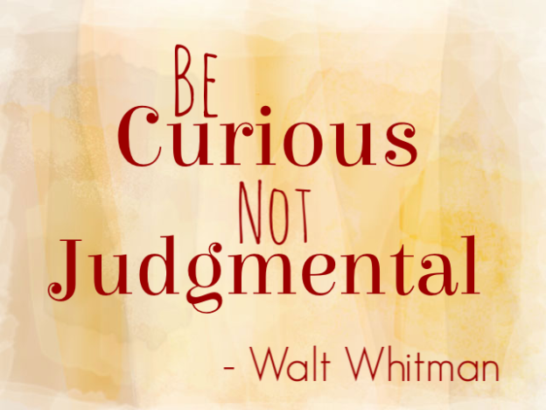

Slide 49
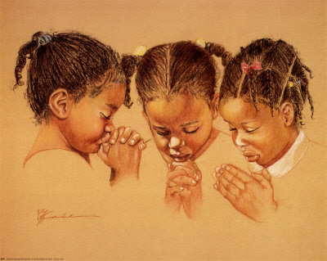
Perspective
God grant me the serenity
To accept the people
I cannot change
Courage to change
the one I can
Wisdom to know
that one is me

Slide 50
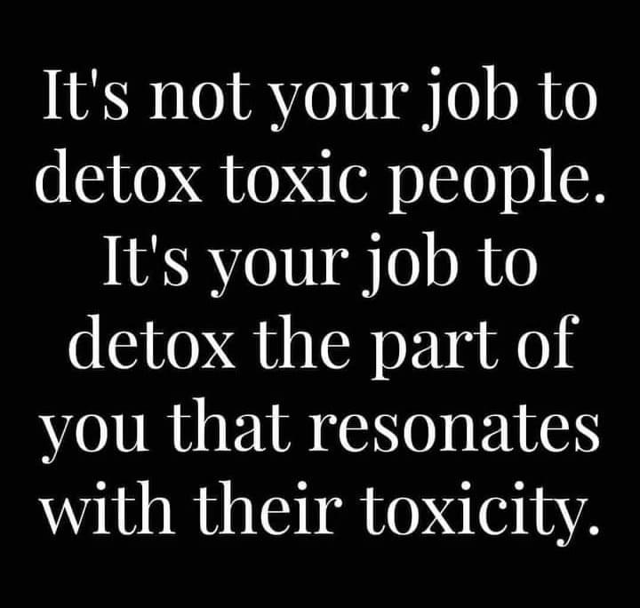

Slide 51
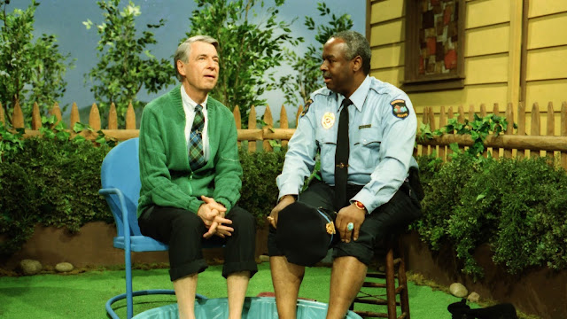
A love of learning
Has a lot
to do with learning
we are
loved.
-Fred Rogers
This Photo by Unknown Author is licensed under CC BY-NC-ND

Slide 52
Tools to restore your Professionalism
& Prevent amygdala hijacks
Physically
Mentally
Tai chi away from trigger
Breathe deeply, deliberately
Step (or look) outside
Take a work break
Eat fruit (glucose to brain)
Laugh, smile
Visit the infant room
Squeeze a stress ball
Text a friend
Touch a talisman
Count to 10 (backwards ;)
Pray or Meditate
Recite a mantra
Recall your favorite inspirational quotation
Help someone else
Ask “How important is it?”
Listen to your gut
Play music in your head
Picture person in underwear

Slide 53
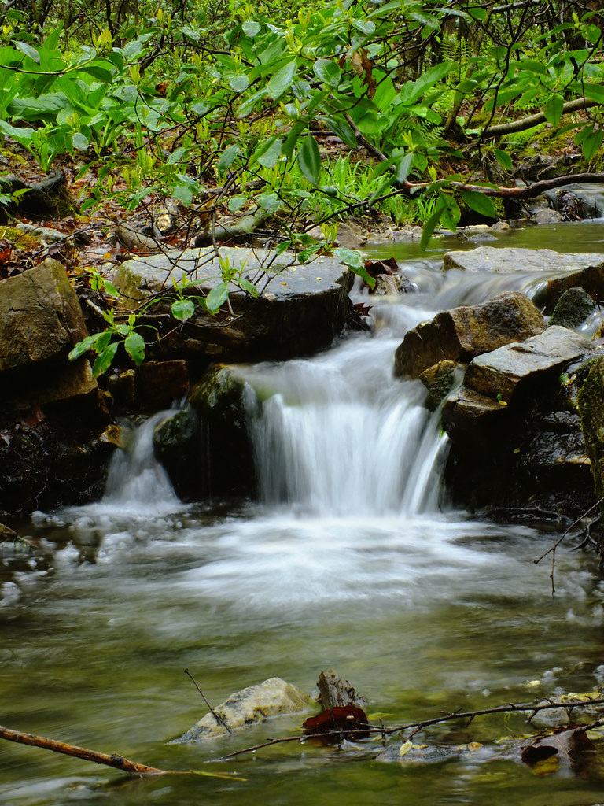
How does NATURE teach us RESILIENCE?
Where do you go to restore your soul?
What’s your sacred place on earth? Holy ground?
Who do you become in your sacred place?
This Photo by Unknown Author is licensed under CC BY

Slide 54
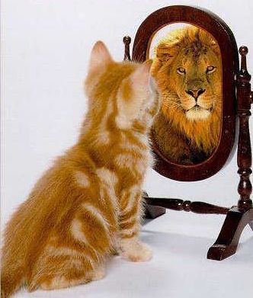
You are braver than you believe
stronger than you think

Slide 55
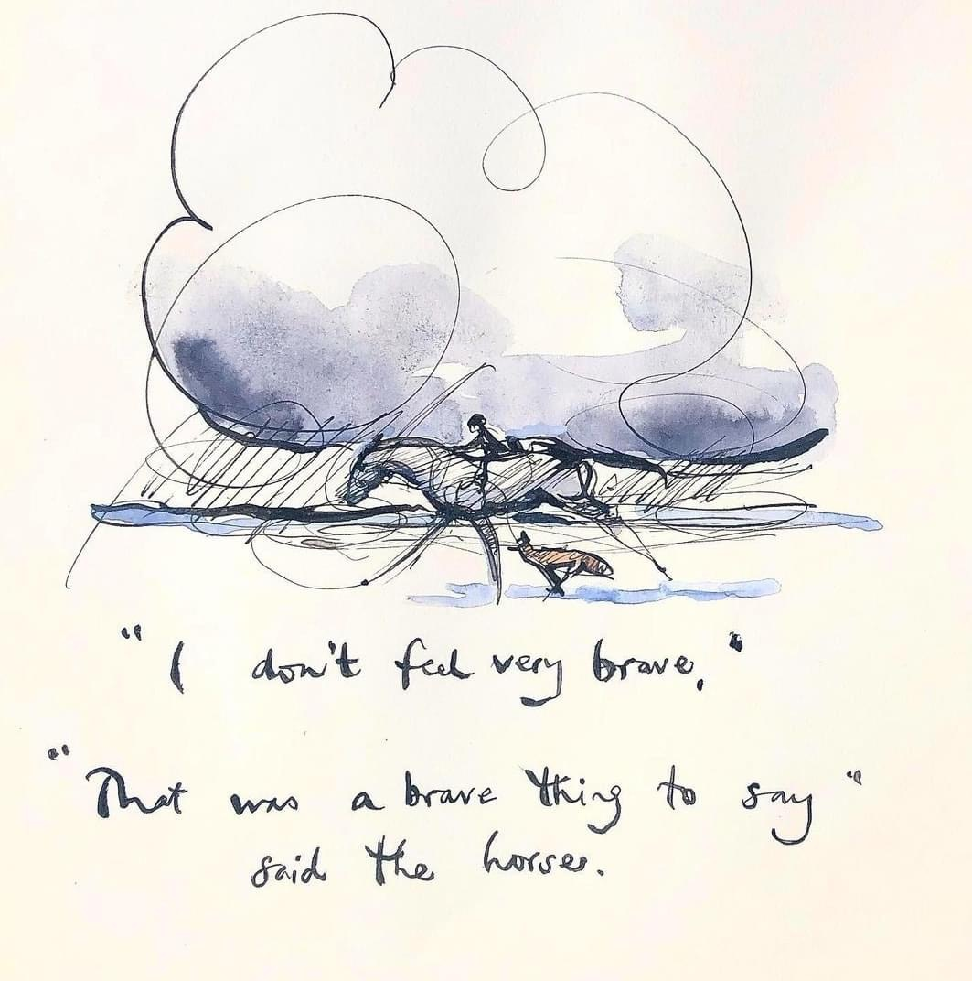

Slide 56
Invite HAPPINESS to be your BFF even/especially in the darkest of times
PREVENTION of plummeting
This Photo by Unknown Author is licensed under CC BY-NC

Slide 57
Choose HOPE over FEAR
HOPE heals
FEAR steals our birthright to joy
This Photo by Unknown Author is licensed under CC BY-SA

Slide 58

I do not fear the night because I have come to love the stars so much
This Photo by Unknown Author is licensed under CC BY-NC

Slide 59
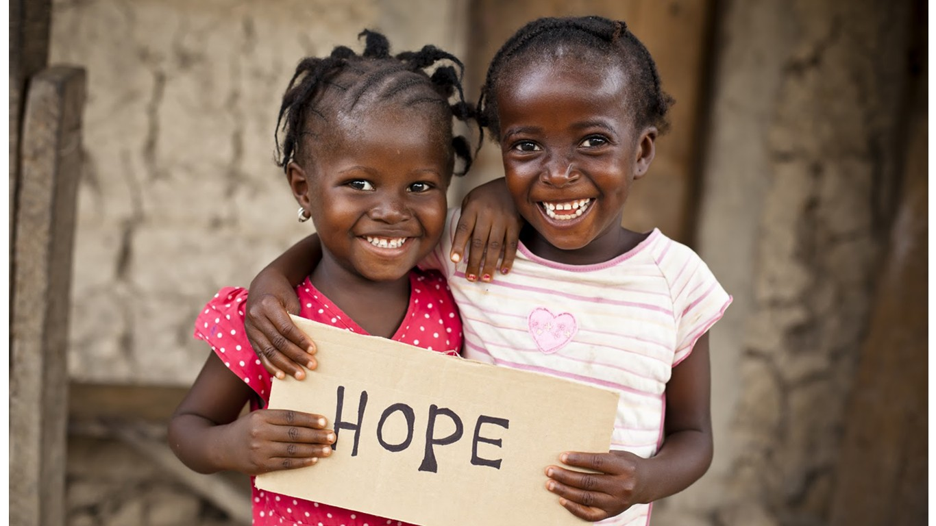
This Photo by Unknown Author is licensed under CC BY-SA

Slide 60
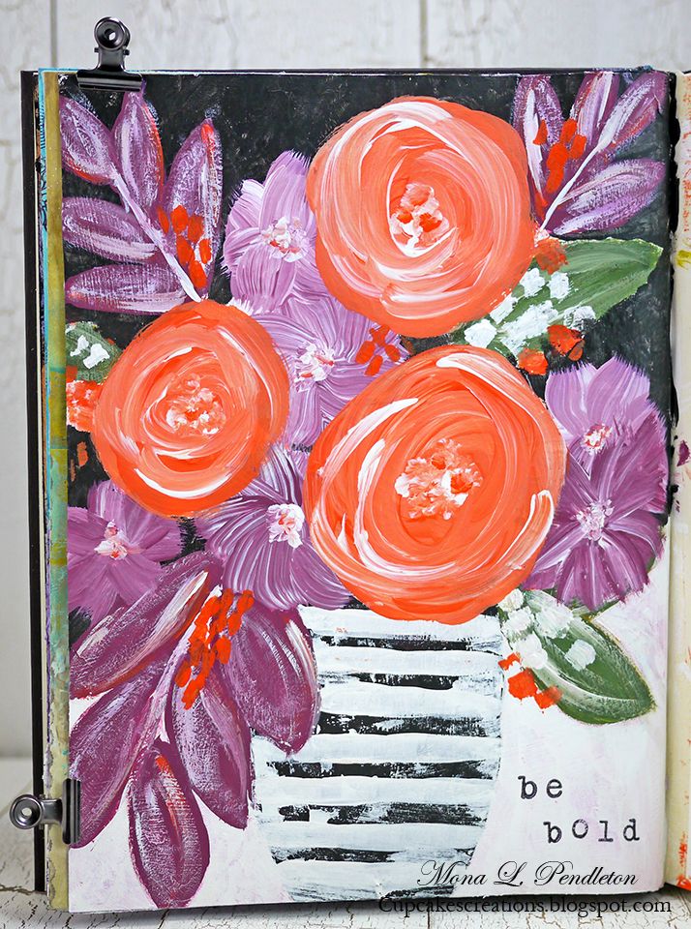
WHAT DOES
HOPE MEAN
TO YOU?
SPELL IT OUT
Requires you to choose:
H_______
O_______
P________
E________
'

Slide 61
Hope helps us find
What’s right with you? Me? Us?
Requires you to choose:
humor
Originality
perspective
Emotional honesty
'

Slide 62
CHOOSE HOPE
CHOOSE LOVE
The healing power of HOPE
This Photo by Unknown Author is licensed under CC BY-NC

Slide 63
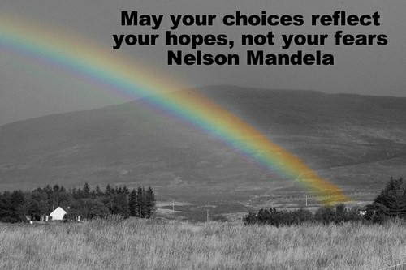
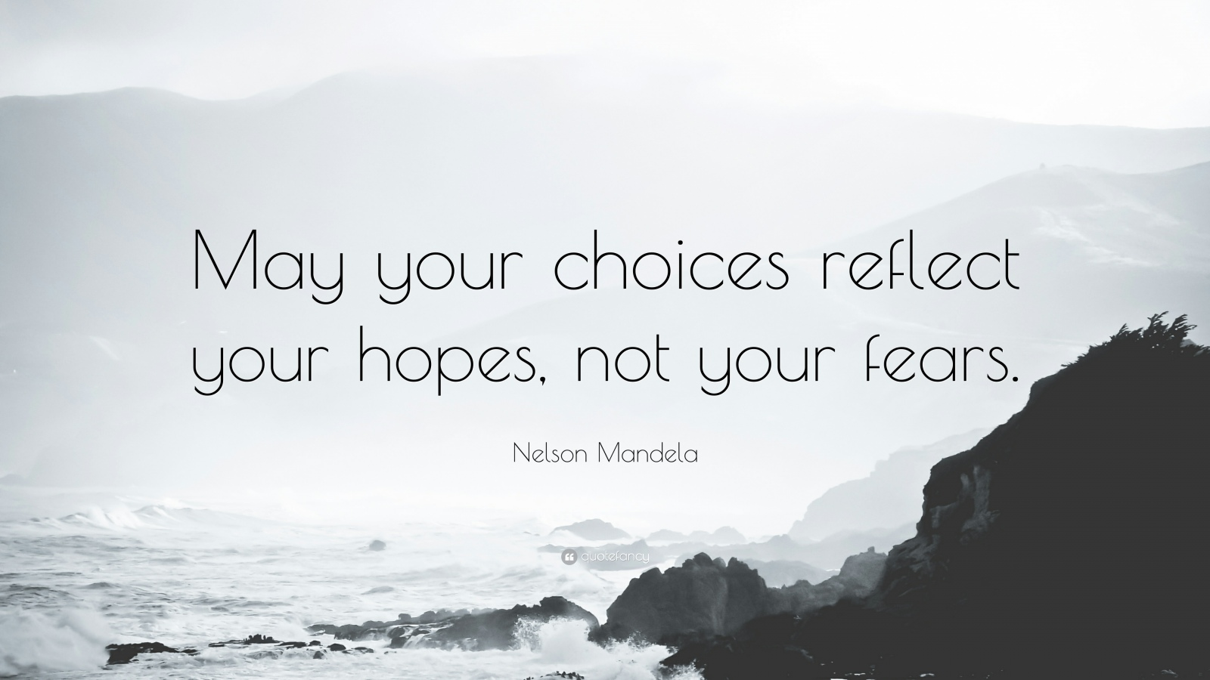
HOPE-based or FEAR-based interactions
This Photo by Unknown Author is licensed under CC BY-NC
This Photo by Unknown Author is licensed under CC BY-NC-ND
Take your BROKEN HEART & turn it into ART

Slide 64
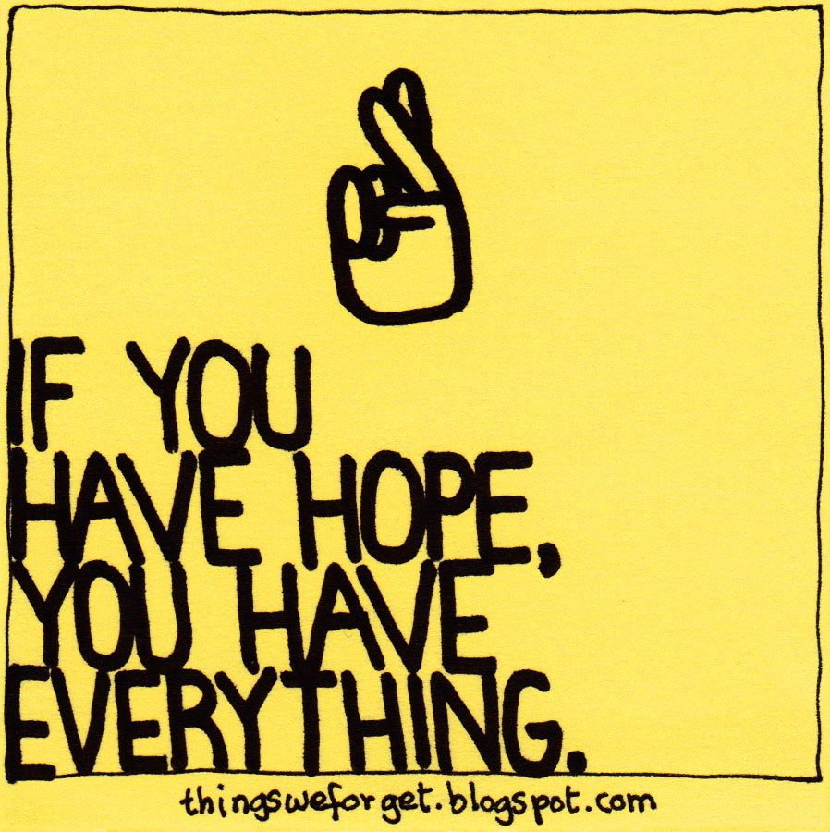
This Photo by Unknown Author is licensed under CC BY-NC-ND

Slide 65
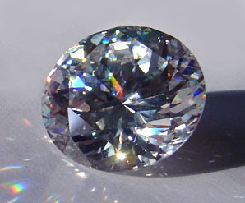
Trauma is my most rigorous guide.
Trauma is my unchosen but compelling pathway to a life of meaning, an uplifting appreciation of beauty, and a deeply anchored conviction to make the world better for every child.
Bruno, Holly Elissa. Happiness is running through the streets to find you:
Translating trauma’s harsh legacy into healing.
Exchange Press, 2020

Slide 66
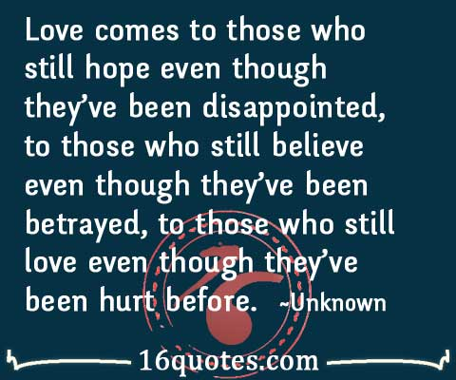
This Photo by Unknown Author is licensed under CC BY-ND

Slide 67
RESILIENCE that “won’t quit, we’ve got this” bounce back against odds capacity derives from______________and how do we make sure it prevails?

Slide 68
How to recalibrate to co-create RELATIONAL SANCTUARIES?
Supportive communities are distinguished by acceptance, hope, curiosity and _____
Your strength in welcoming people who differ from you________

Slide 69
Nobody else can live the life you live.
And, even though no human being is perfect,
We always have the chance to bring what’s unique about us to life.
Fred Rogers

Slide 70
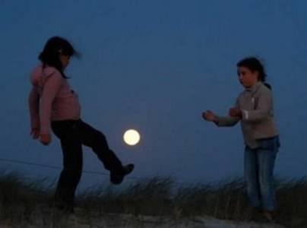
To grow through hard times, children & adults need to feel
Inner control: Free to choose
Joy: experience awe, curiosity, wonder
Connection: support one another with respect and love
Hope: be an actor rather than a reactor (survivor rather than victim)
Playmakers, LIFE IS GOOD Foundation

Slide 71
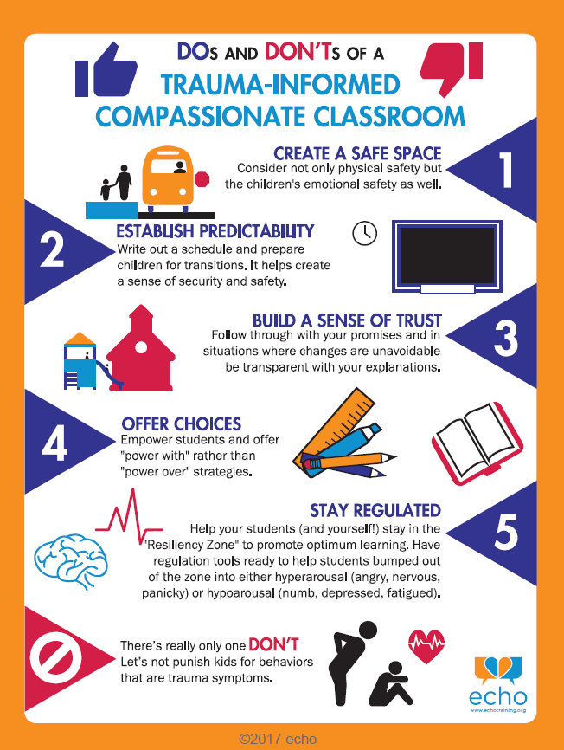
71

Slide 72
Resiliency requires Safety, freedom from threat of harm, loss, danger consists of
Freedom from threat
Inner confidence. You know you:
Help from team
Unwanted surprises
Disrespect
Violence
Cruelty
Shaming
Abuse
Humiliation
Danger to body or soul
Abandonment
Matter, have value
Can honor your boundaries
Are heard, seen
Treated fairly
Your voice is respected
Kindness prevails
Feelings are honored
Loss is acknowledged
Won’t allow anyone to hurt you
Help is available
Helpers are competent
You have caring support
Don’t have to do it all alone
No retribution or retaliation
Vulnerability will not be exploited
Differences honored
“I respect what you say because it is true for you”

Slide 73
The toughest thing is to love somebody who has done something mean to you, especially when that somebody is yourself.
Look inside yourself and find that loving part of you. Take good care of that part because it helps you love your neighbor.
-Fred Rogers

Slide 74
Your expectations for yourself:
Pre-judging/Bias vs. Desire to Learn
Your behavior
How you choose to respond
You make a mistake, fail at something that matters to you
You find yourself comparing yourself to another person (rather than identifying with that person) and coming up short
You suddenly feel ashamed of yourself, inadequate, unable, immature/unworthy
You feel stuck; things are getting old and uninspiring
You conflict with another person; but, you can’t bear confrontation
Self unfulfilling prophecy____________
If you pre-judge yourself negatively, what would you say/do?
Curiosity______________
If you want to learn about yourself and your emerging choices, what can you say/do?

Slide 75
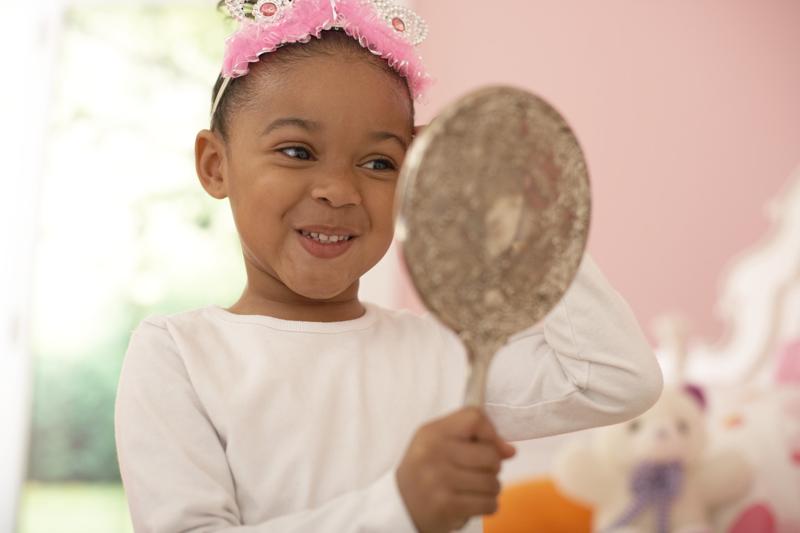

LIFE’S TOO SHORT
To do anything
BUT
Enjoy it everyday!

Slide 76
To honor your BFF, HAPPINESS
KEEP
CHOOSING
HOPE over
Fear.
This Photo by Unknown Author is licensed under CC BY-NC

Slide 77
Your spiritual intelligence

Slide 78

WE ARE THE MOST SPIRITUAL
WHERE WE ARE THE MOST BROKEN
-HENRI NOUWEN, WOUNDED HEALER

Slide 79

Translating trauma’s harsh legacy into healing
Become our true selves
Embrace our difficulties
Love the unlovable in ourselves & others
Connect to joy, beauty and one another

Slide 80

RELATIONAL SANCTUARIES heal with:
Safety
Acceptance
Unconditional Love
Playfulness
Freedom from damning judgment
In community

Slide 81

Name one difference you dearly want to make having lived through these traumatic times
Be bold
Be brave
You must do the thing you think you cannot do.
Waste your heart on fear no more.
This Photo by Unknown Author is licensed under CC BY-NC-ND
This Photo by Unknown Author is licensed under CC BY-NC

Slide 82

It’s high time to rewrite Humpty Dumpty: Offer HOPE
This Photo by Unknown Author is licensed under CC BY-SA-NC

Slide 83
Mental health statistics after 2 years of pandemic: What would you expect them to be?
Mental Health Pandemic
Exacerbated by feeling
40.9% Americans report adverse effect (anxiety, depression, trauma response, substance abuse, suicide) CDC
Young children suicides up 47% for 5-8 year olds: 182% 9-12 year olds in 1st ¾ of 2021 (JAMA)
Domestic violence globally skyrocketing 50%; prior to covid, already 1 of 3 women abused. CSAJ, Center for Survivor Advocacy/Justice
Same sex couple abuse equally or higher frequency
happiness
anxiety
trust
PTSD/CPTSD
ISOLATION
SOCIAL SKILLS
LEARNING
Trapped (no exit)
Isolated (no contact)
No respite (hypervigilance)
Despair, hopelessness
Code of silence returns “Don’t talk, trust or feel”
-Dr. Claudia Black
White paternalism
Mental health pandemic.

Slide 84
The choice is yours:
Will you choose hope or fear, promise or dread, kindness or shame what’s right or what’s wrong?
YES or NO to your grand adventure?

